Slide 1

Cloud Understanding
Dr. A. Suresh, INSOFE

Slide 2
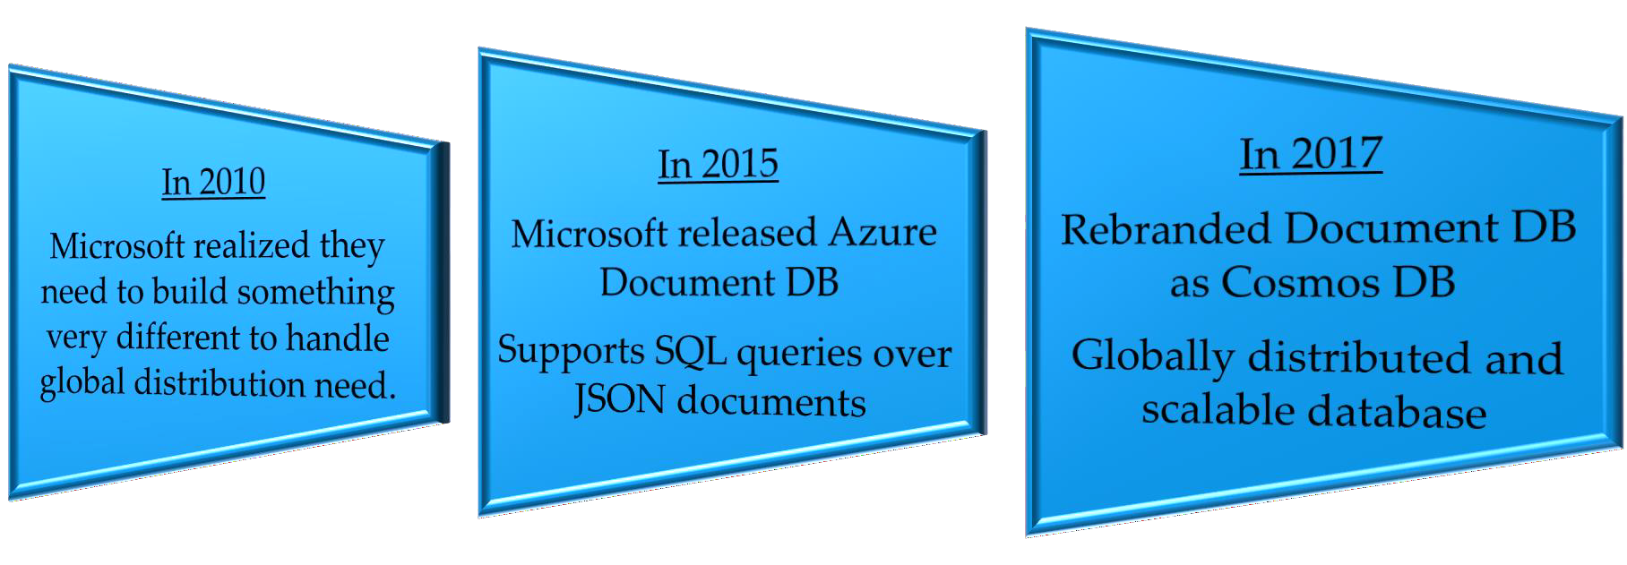
How Cosmos DB evolved?

Slide 3

Why Cosmos DB?
FULLY MANAGED
Database as a service (DaaS)
Serverless architecture
No operational overhead
No schema or Index management
GLOBALLY DISTRIBUTED
Turnkey global distribution
CONSISTENCY CHOICES
Azure Cosmos DB's support for consistency levels like strong, eventual, consistent prefix, session, and bounded-staleness.
SCALABLE
Unlimited scale for both storage and throughput.
MULTIMODEL & MULTI-LANGUAGE
Supports Jason documents, table graph and columnar data models
Java, .NET, Python, Node.js, JavaScript, etc.
HIGHLY AVAILABLE, RELIABLE & SECURE
Always on
99.999% SLA
< 10ms latency

Slide 4


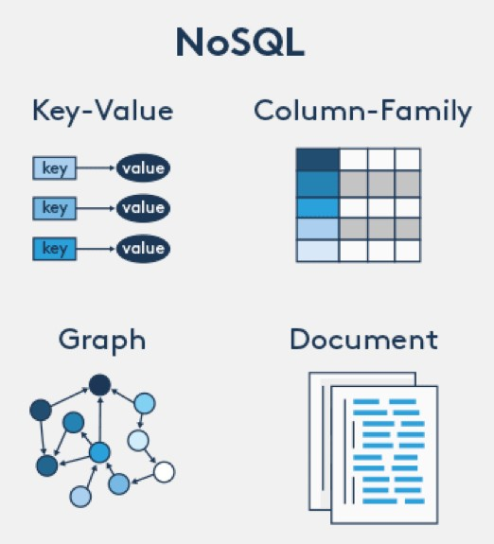










Multi Model

Slide 5
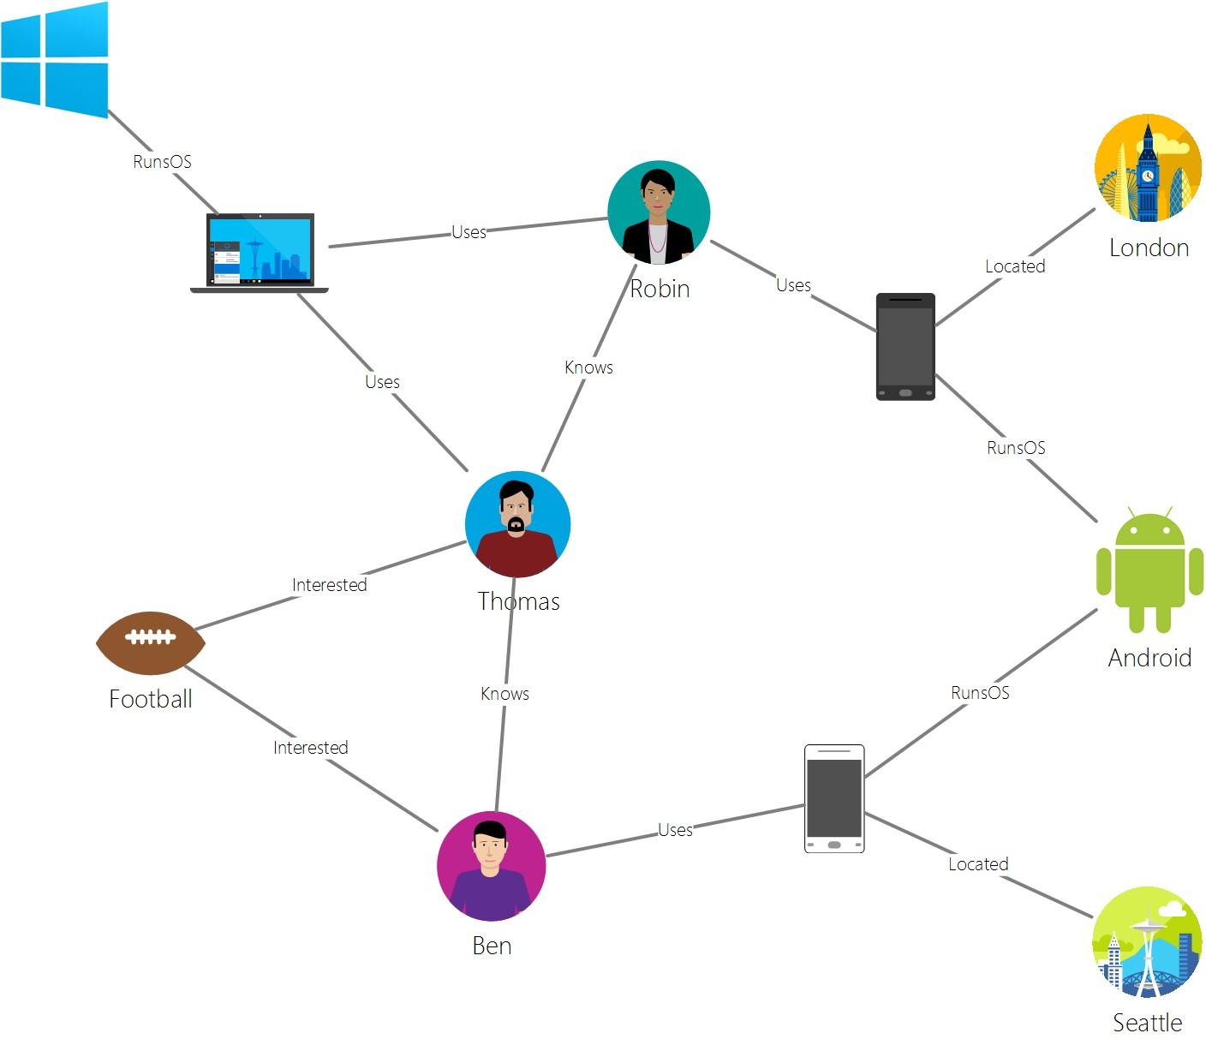
Graph Model

Slide 6
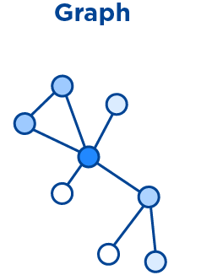
Cosmos DB Gremlin API
Graph Data Model
Real world data connected with each other
Graph database can persist relationships in the storage layer
Use cases
Social networks
Recommendation engines
Geospatial
Internet of things
Migrate existing apps to Cosmos DB Gremlin API
Graph traverse a language

Slide 7
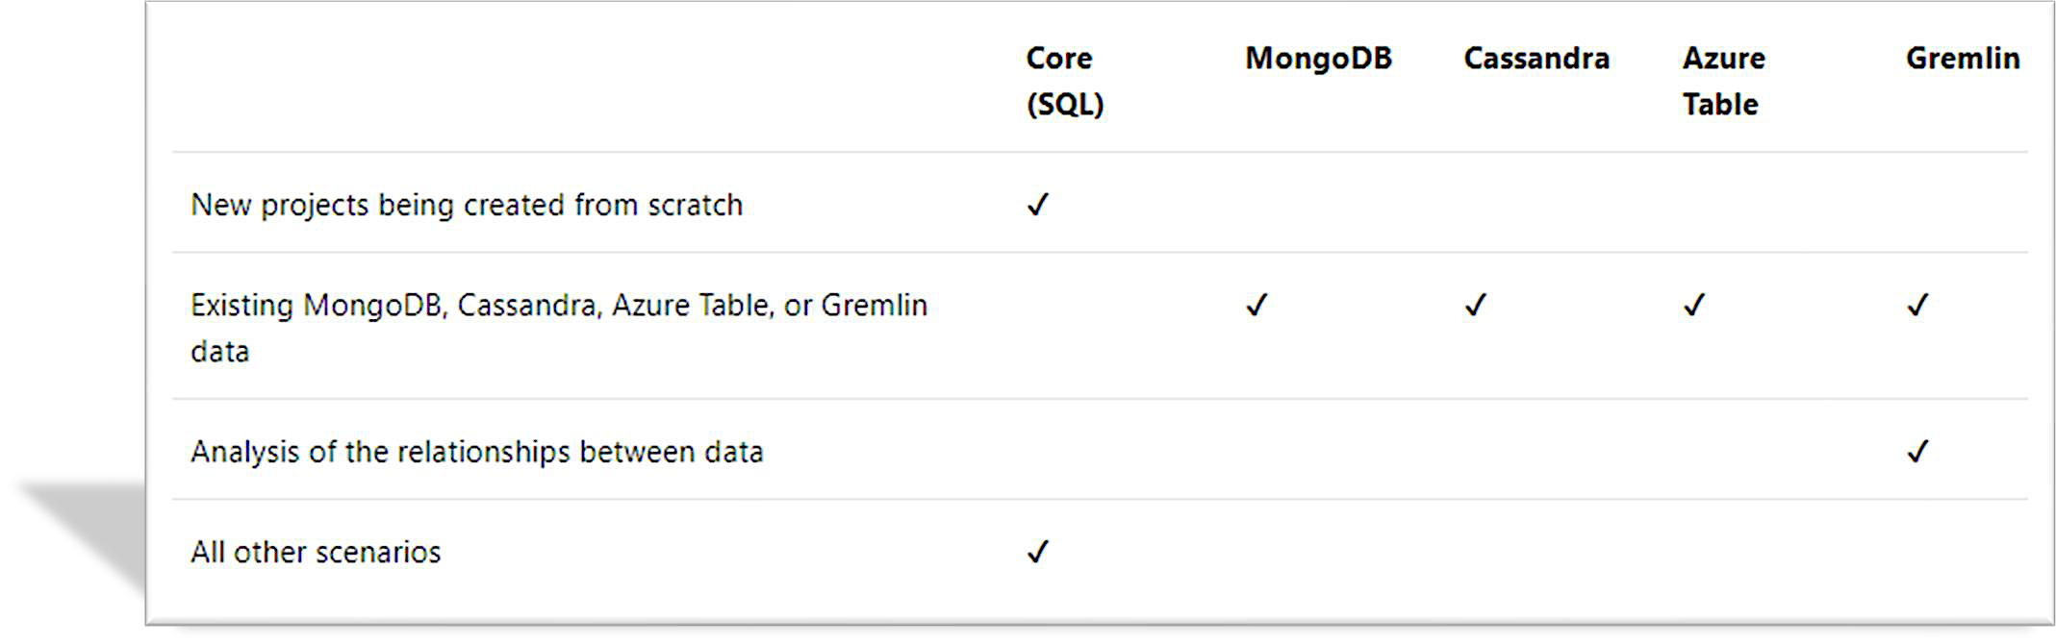
Analyze the decision criteria

Slide 8
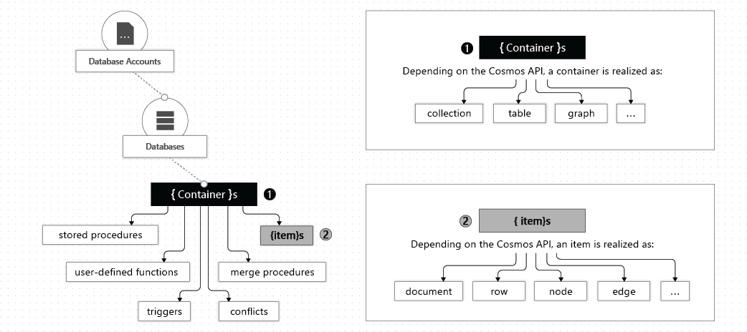
Database Containers and Items
Azure Cosmos entity | SQL API | Cassandra API | MongoDB API | Gremlin API | Table API
Azure Cosmos database | Database | Keyspace | Database | Database | NA
Azure Cosmos container | Container | Table | Collection | Graph | Table
Azure Cosmos item | Document | Row | Document | Node or edge | Item

Slide 9
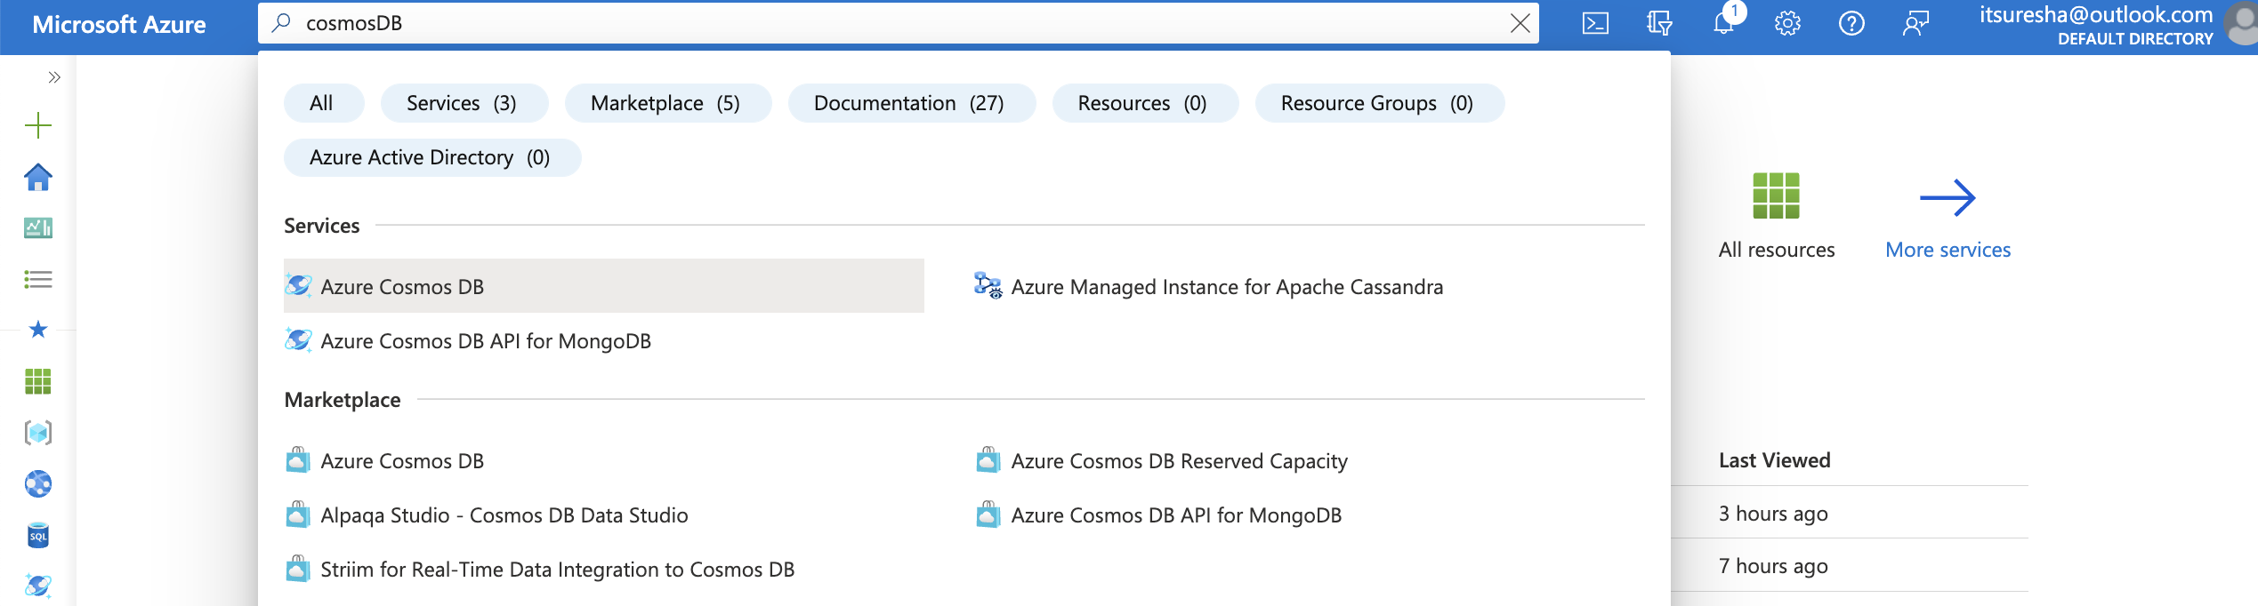
Core SQL

Slide 10
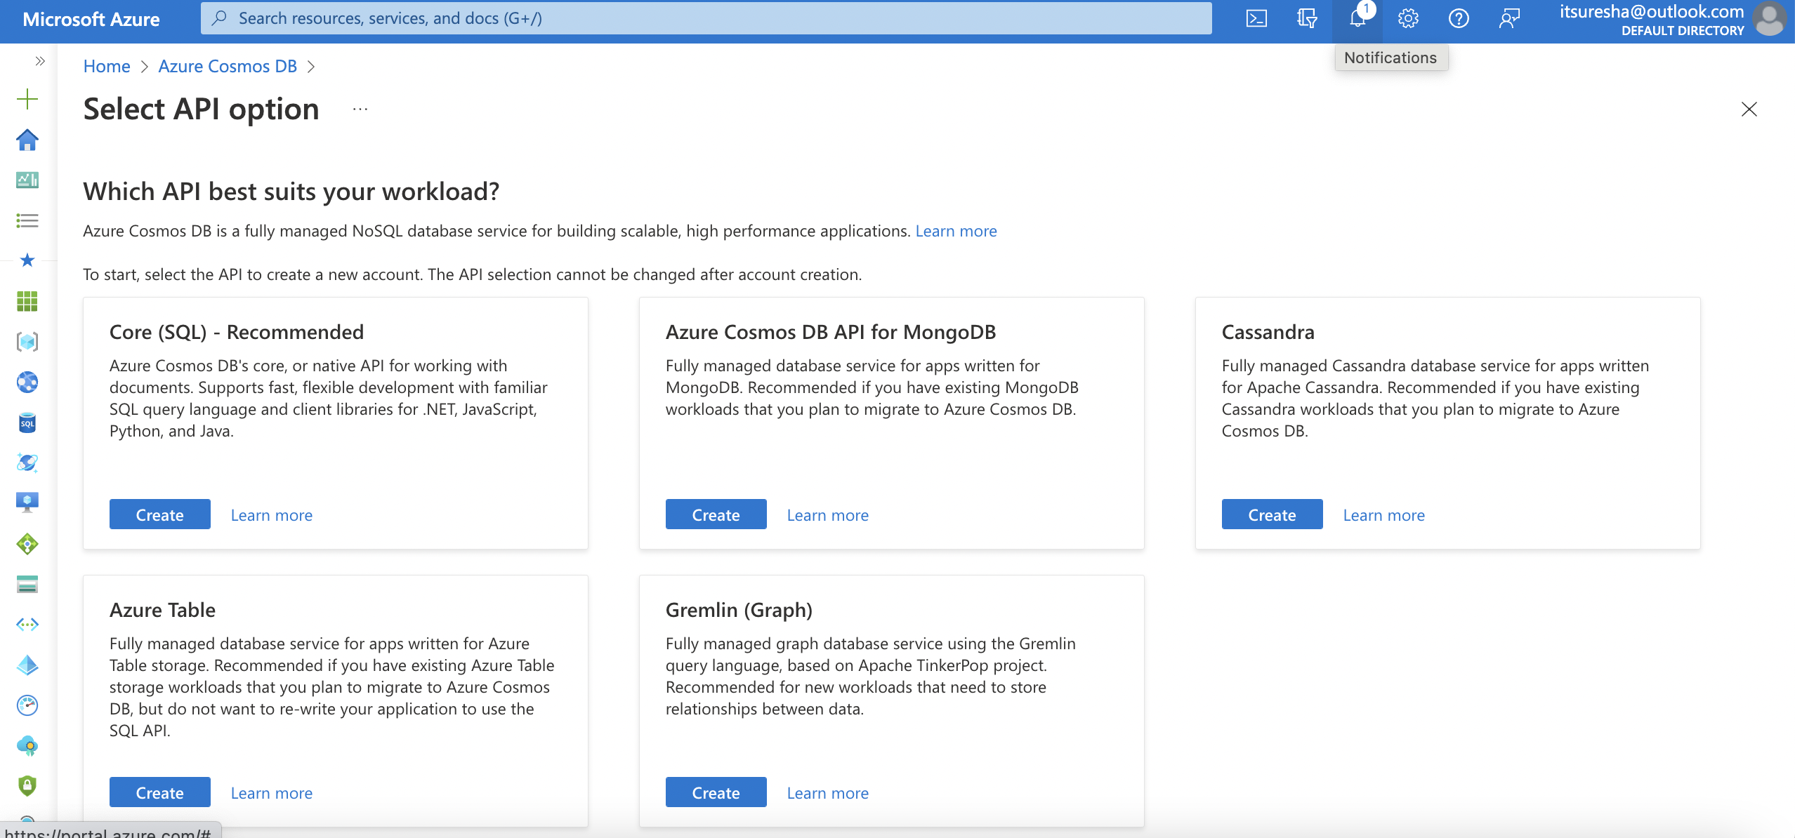
Core SQL

Slide 11
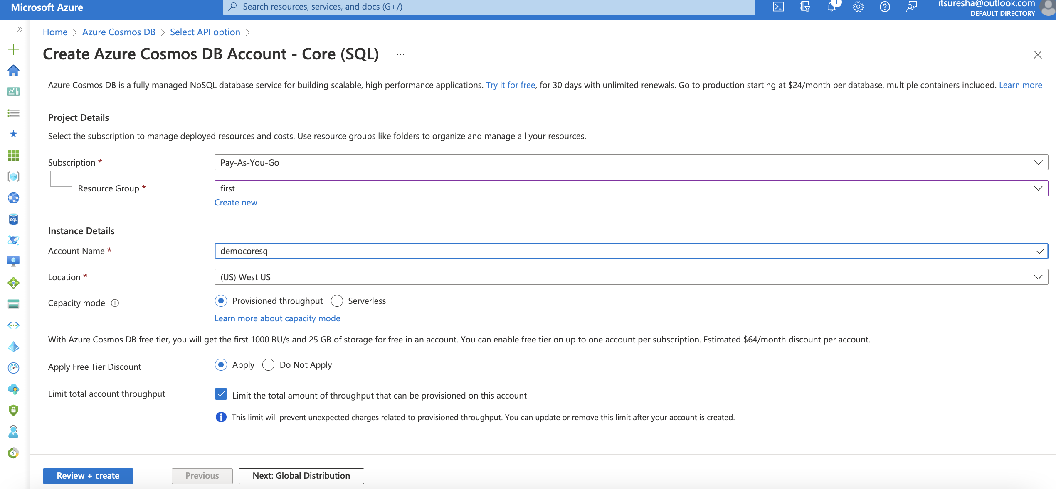
Core SQL

Slide 12
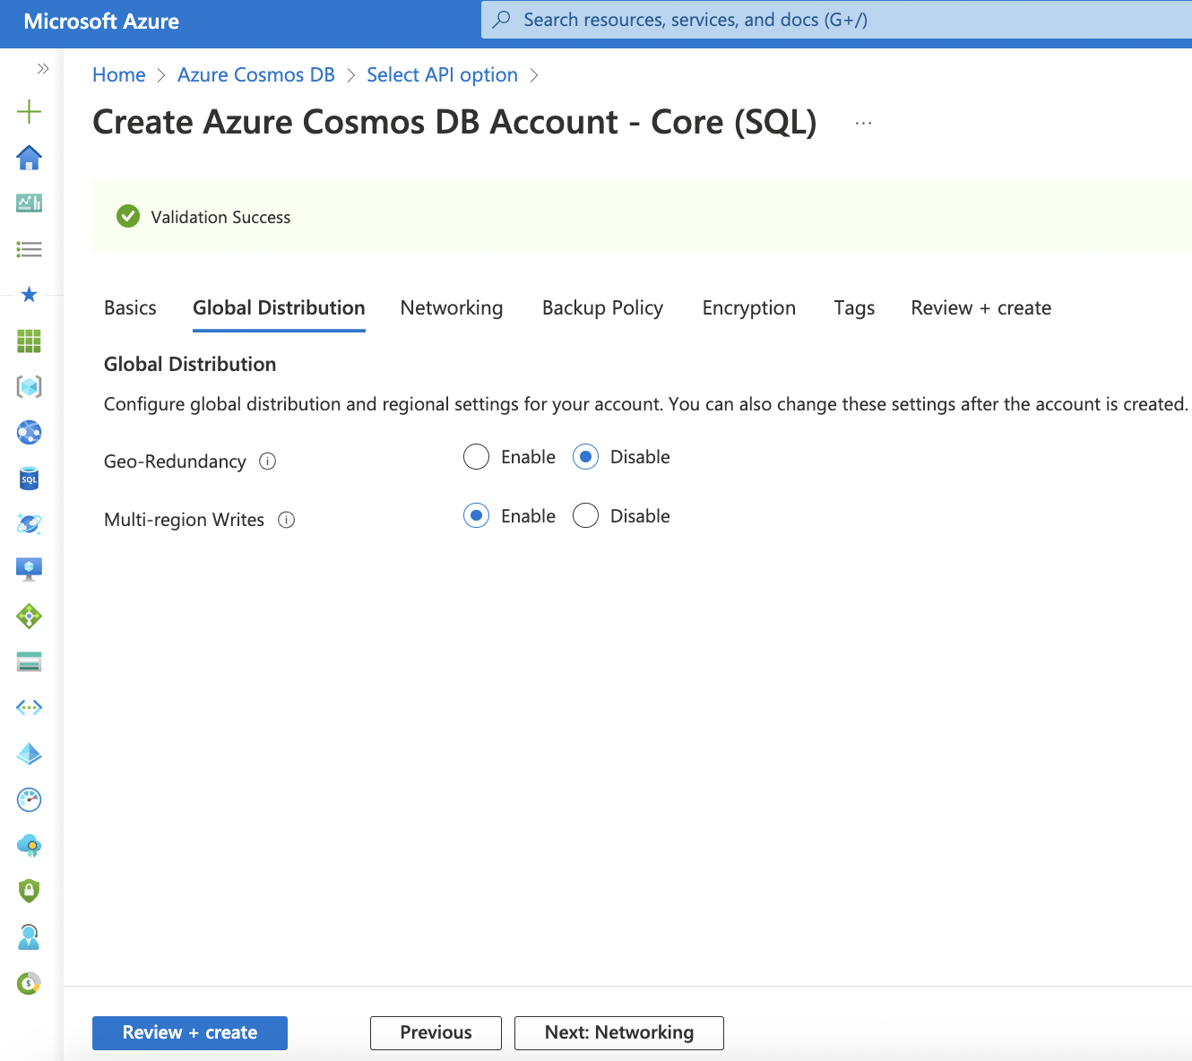
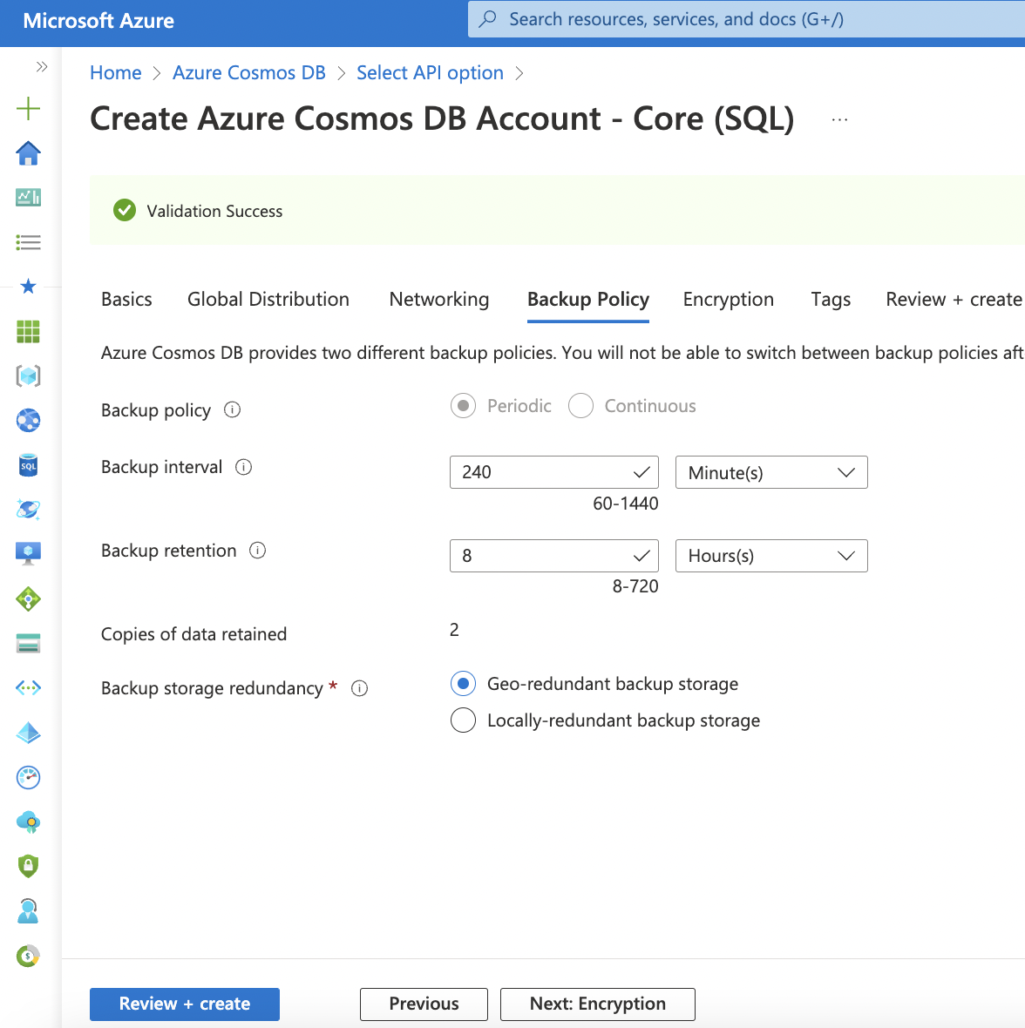
Core SQL

Slide 13
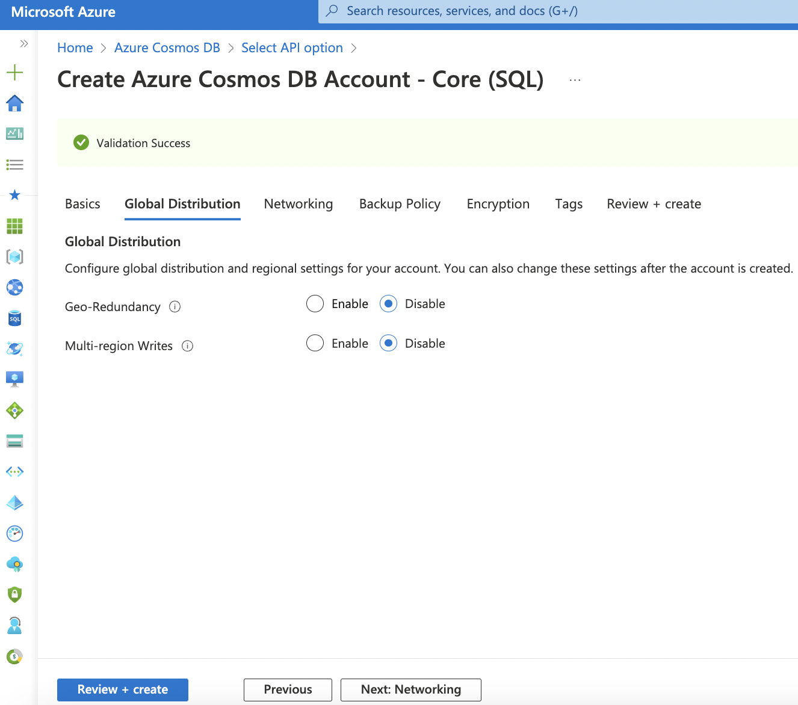
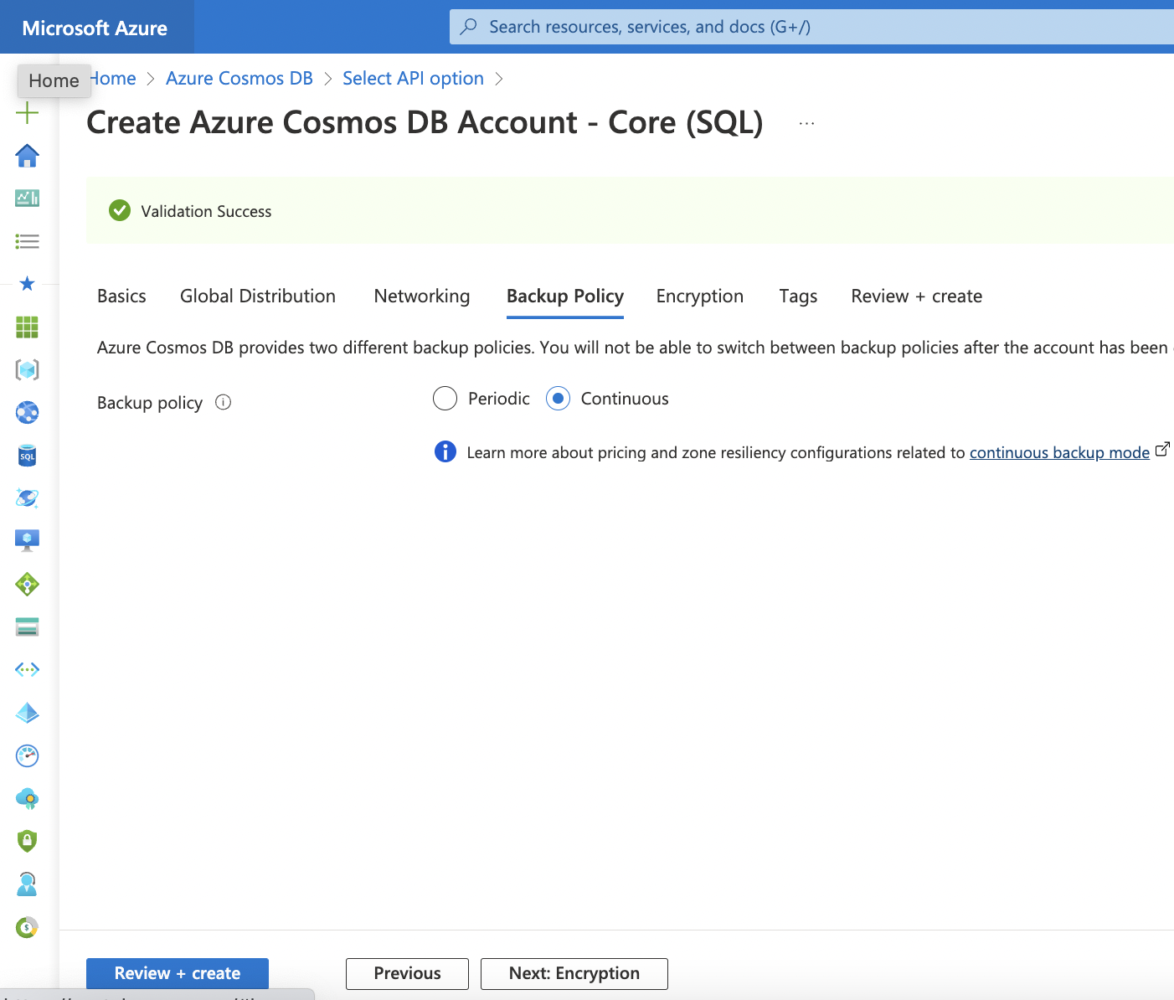
Core SQL

Slide 14
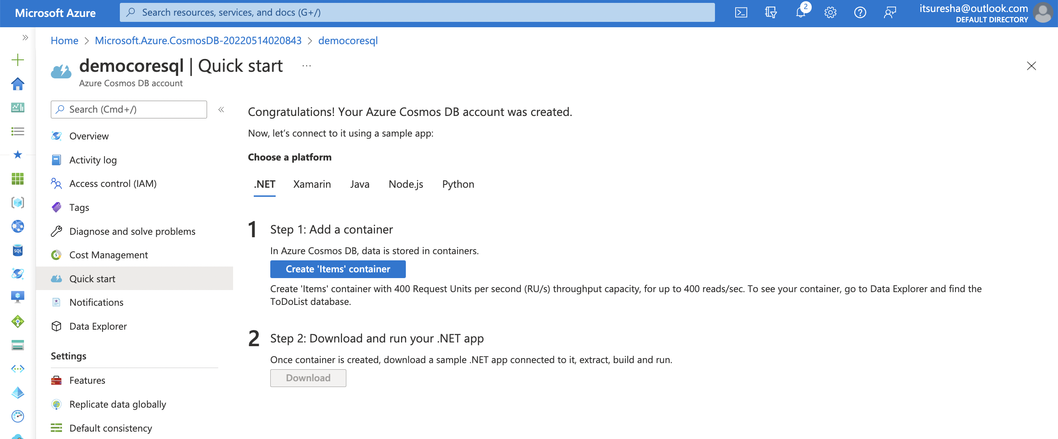
Core SQL

Slide 15
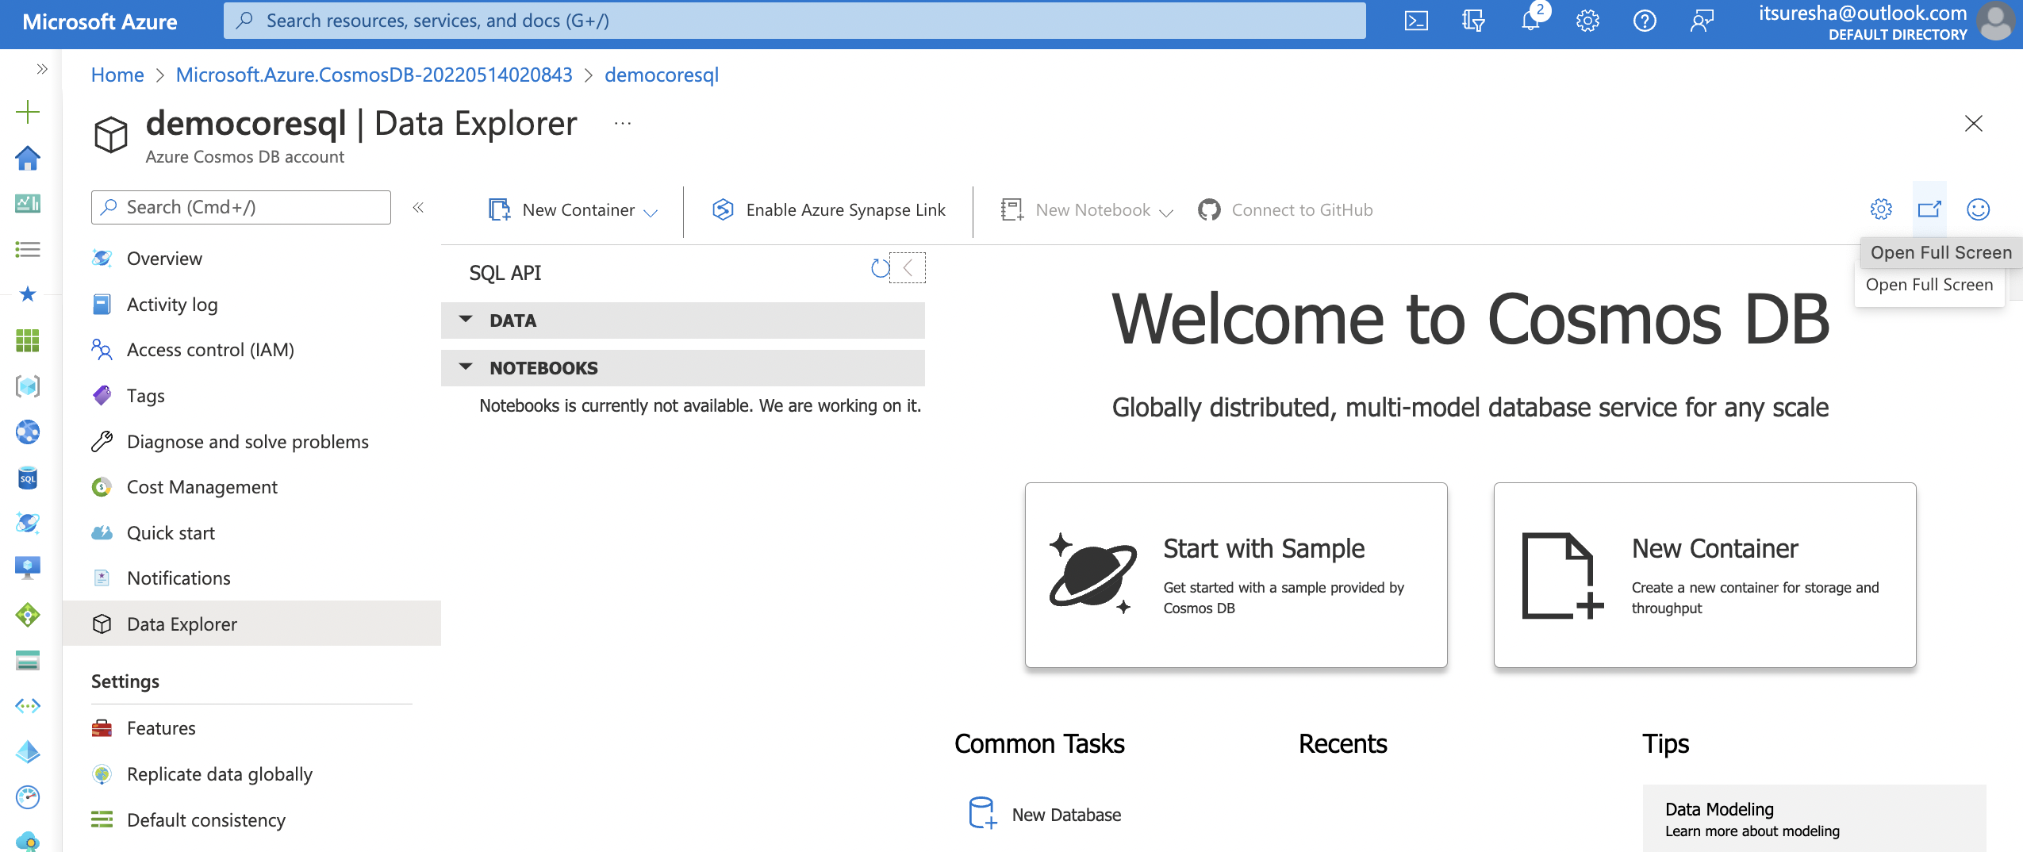
Core SQL

Slide 16
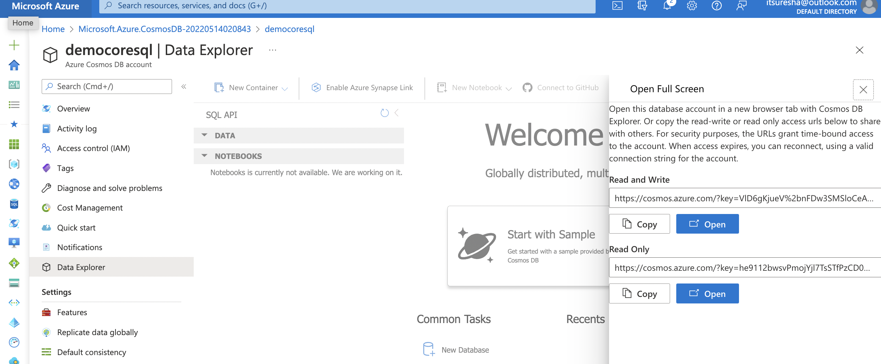
Core SQL

Slide 17
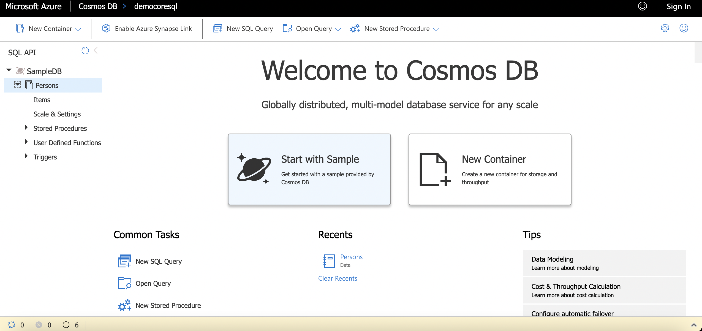
Core SQL

Slide 18
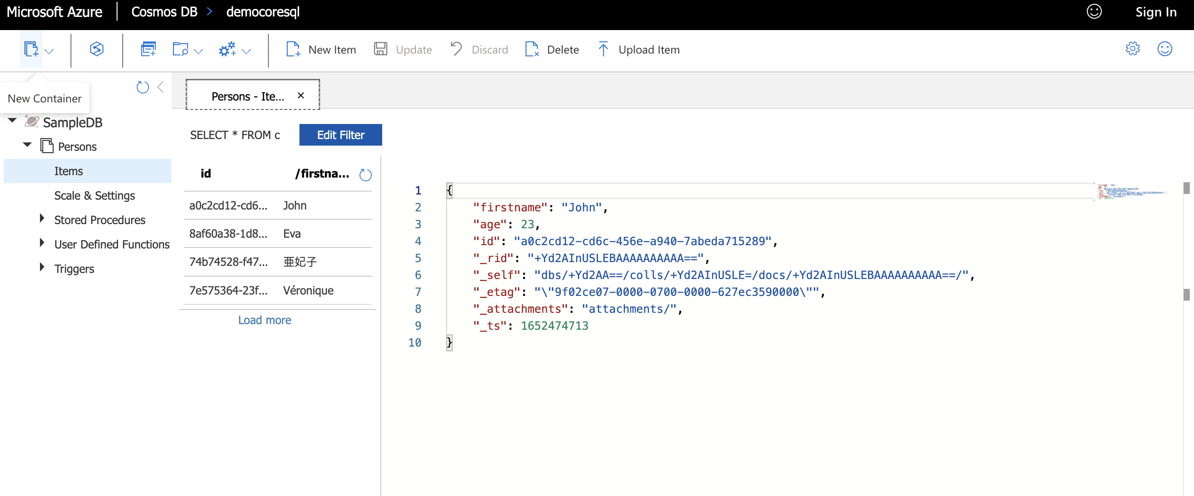
Core SQL

Slide 19
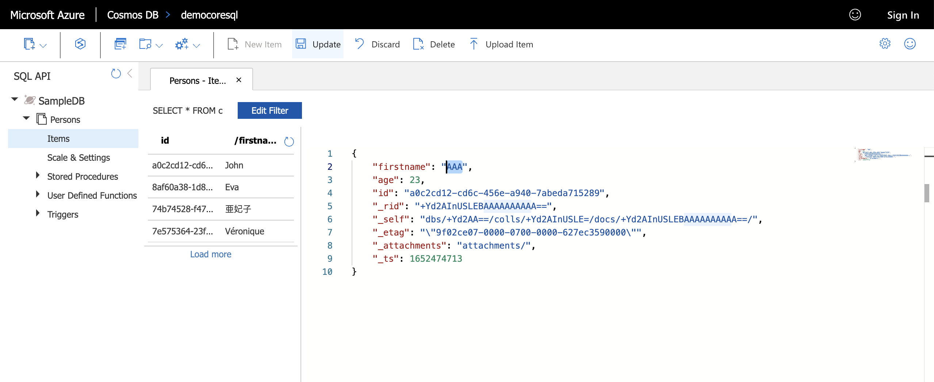
Core SQL

Slide 20
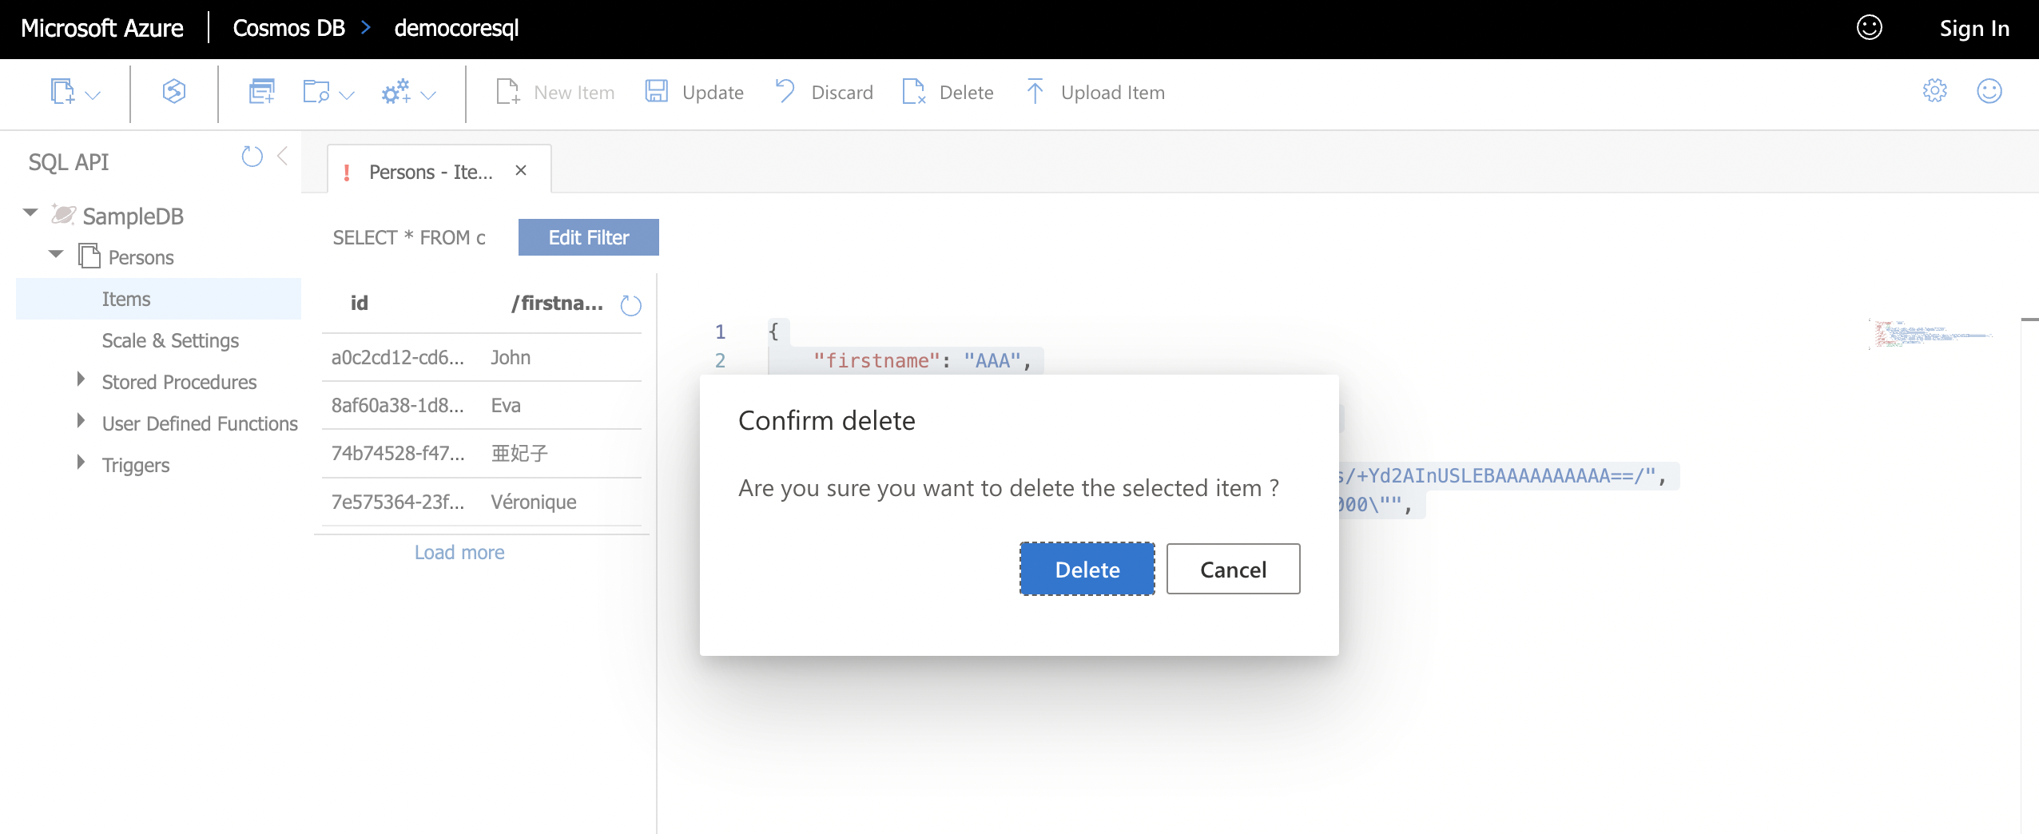
Core SQL

Slide 21
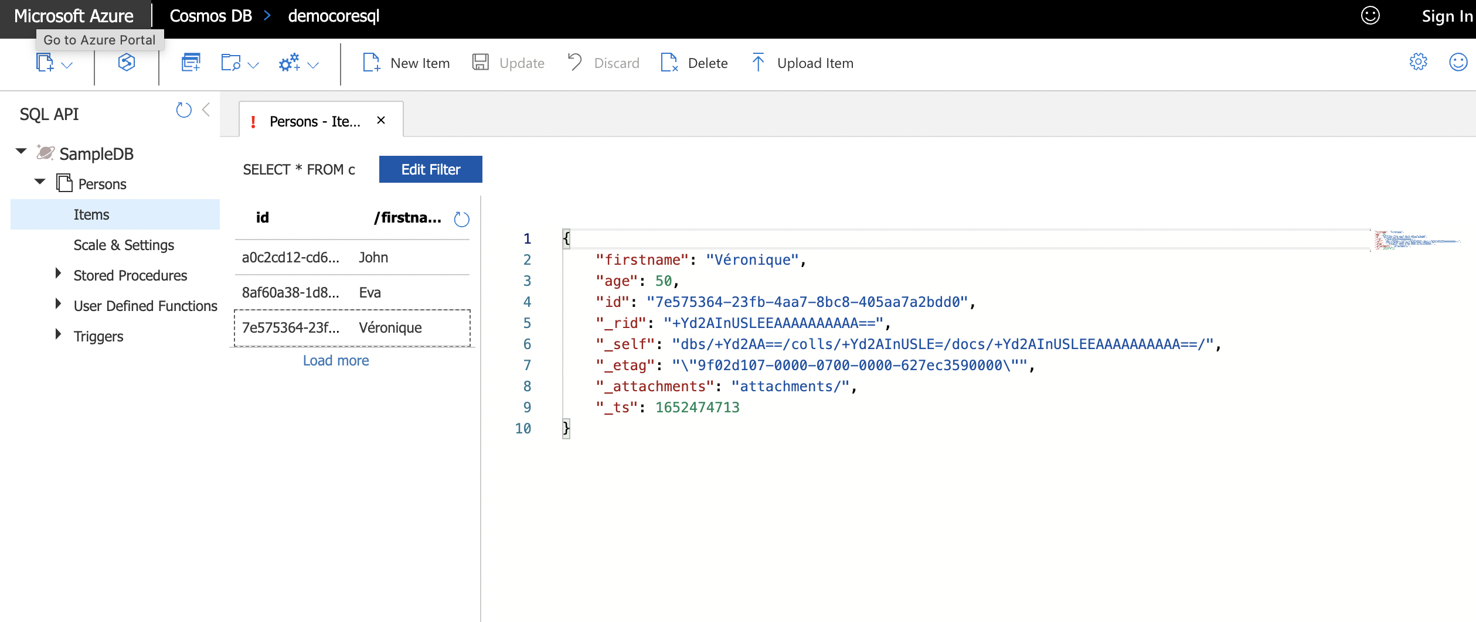
Core SQL

Slide 22
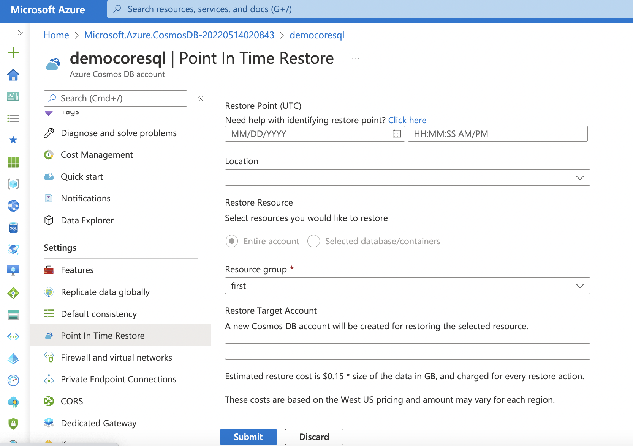
Core SQL

Slide 23
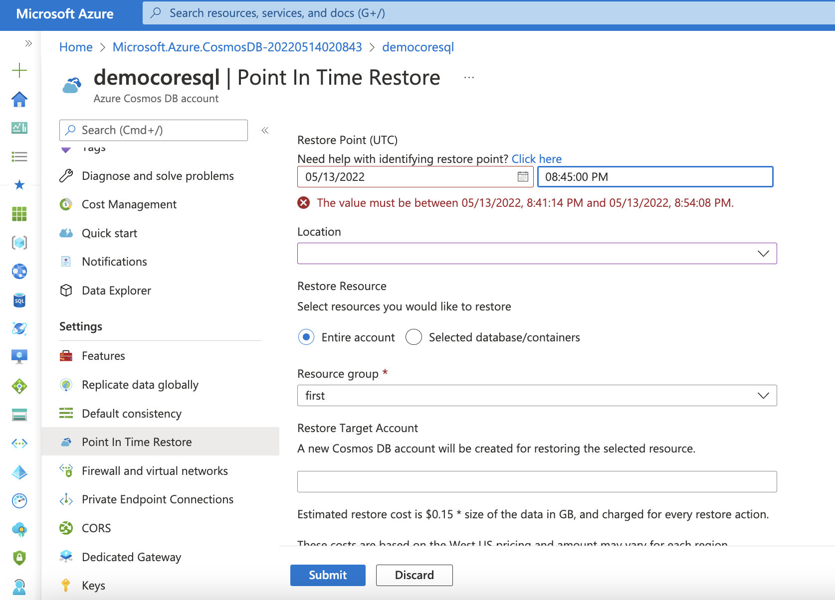
Core SQL

Slide 24
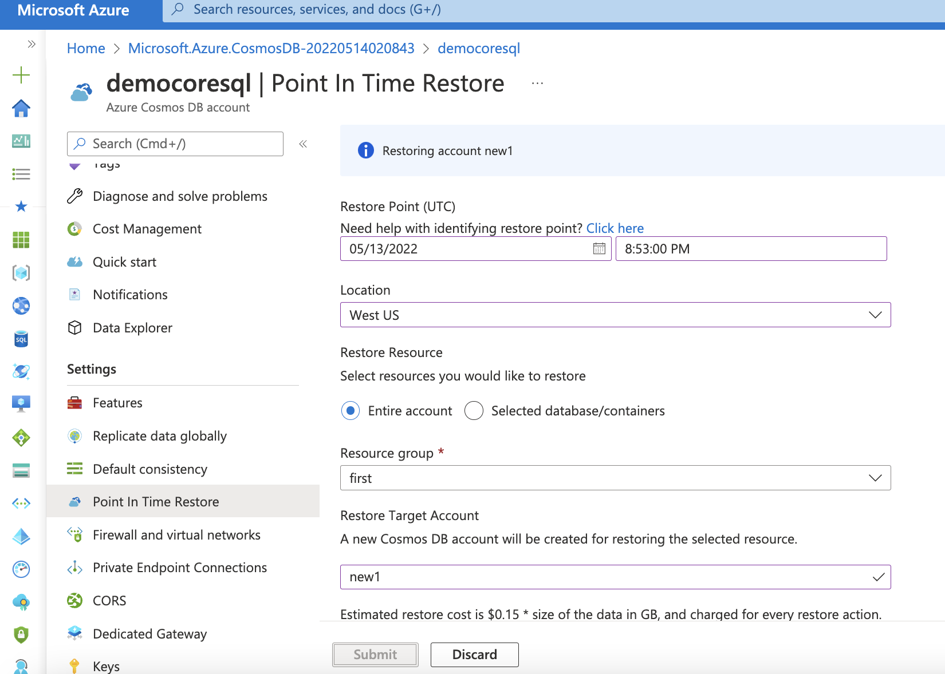
Core SQL

Slide 25
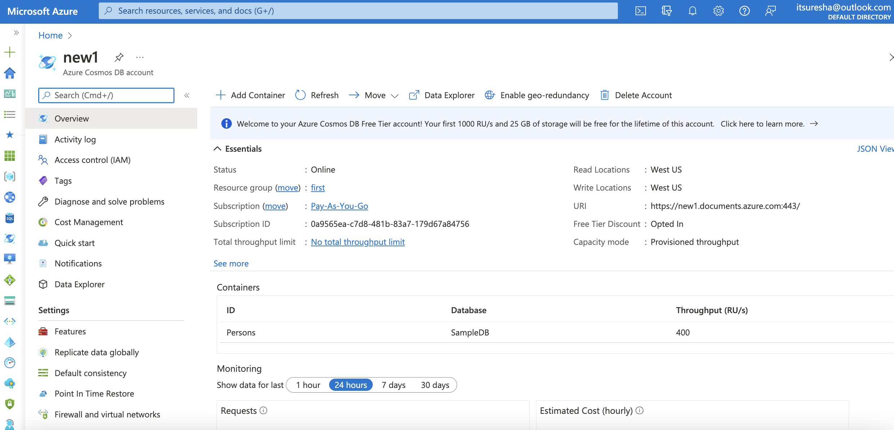
Core SQL

Slide 26
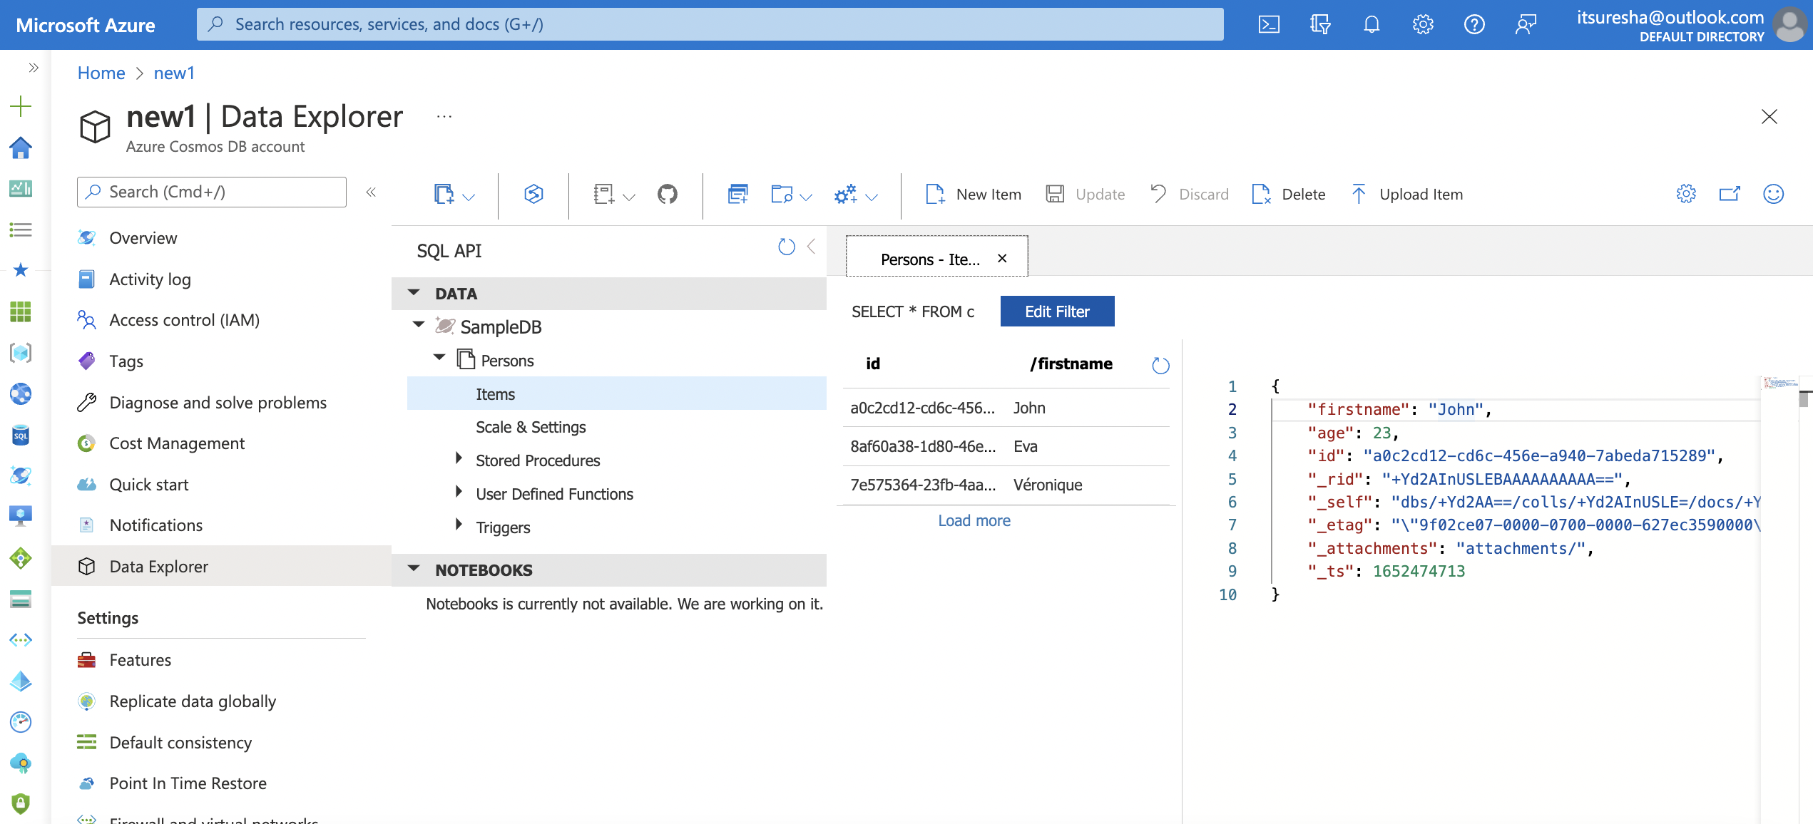
Core SQL

Slide 27
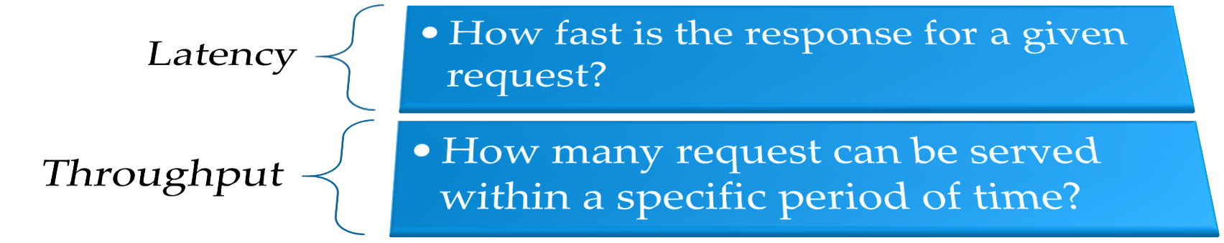
Measuring Performance

Slide 28
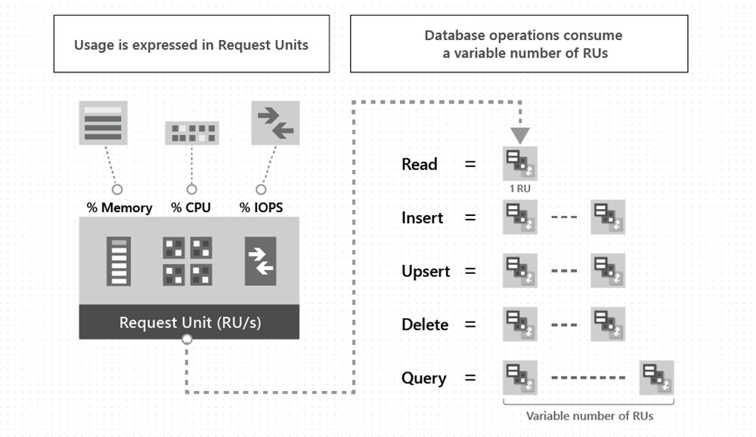
Introducing Request Units

Slide 29
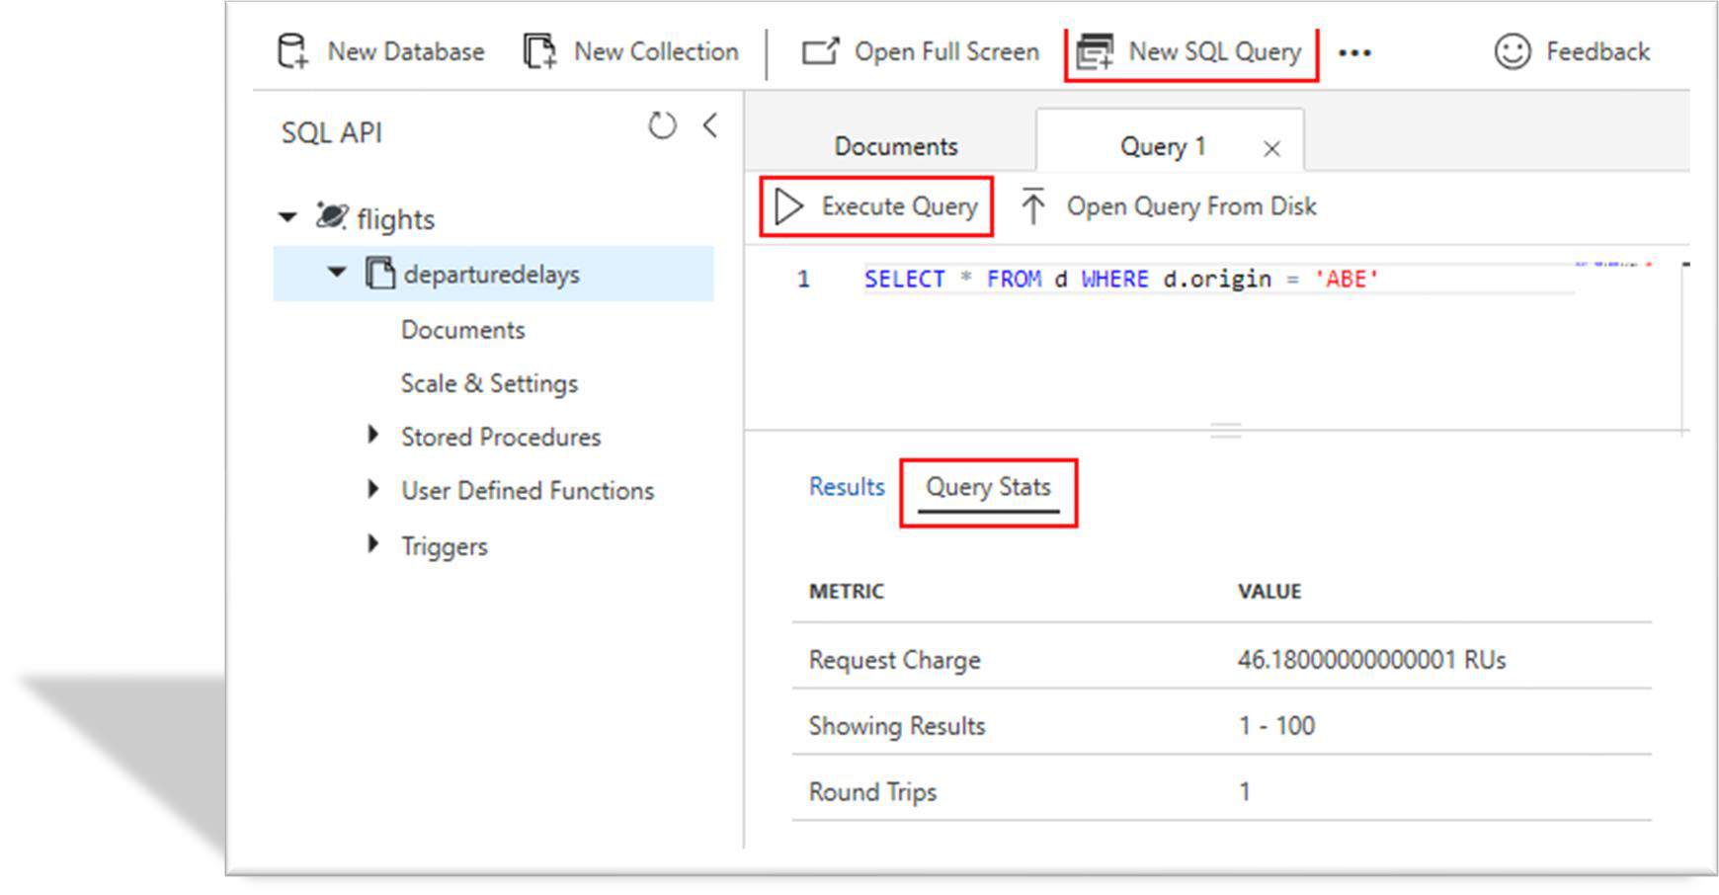
Introducing Request Units

Slide 30
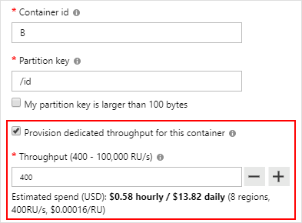
Reserving Requests Units
Provision Request units per second (RU/s)
How many request units (not requests) per second are available to your application
Exceeding reserved throughput limits
Requests are “throttled” (HTTP 429)

Slide 31
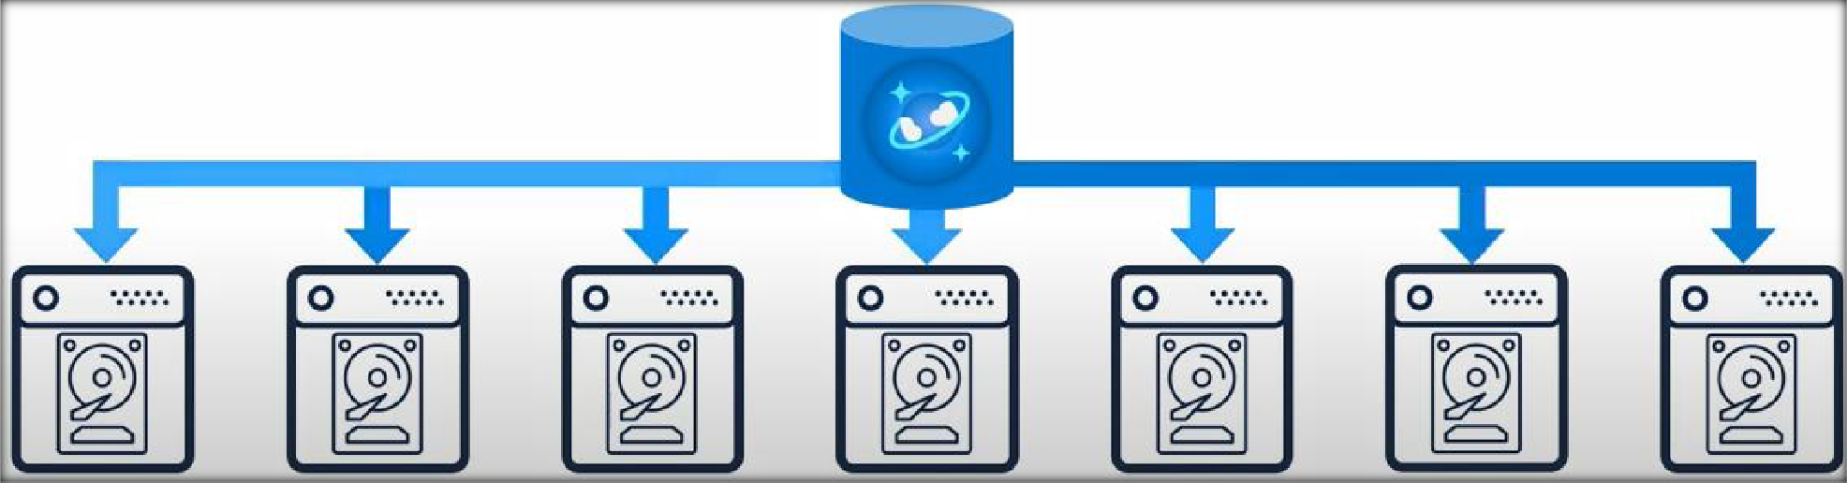




Horizontally Scalable
Unlimited Storage
Unlimited Throughput

Slide 32
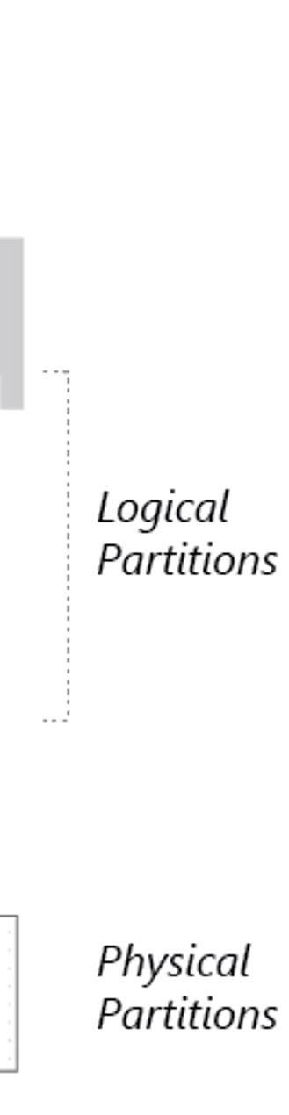
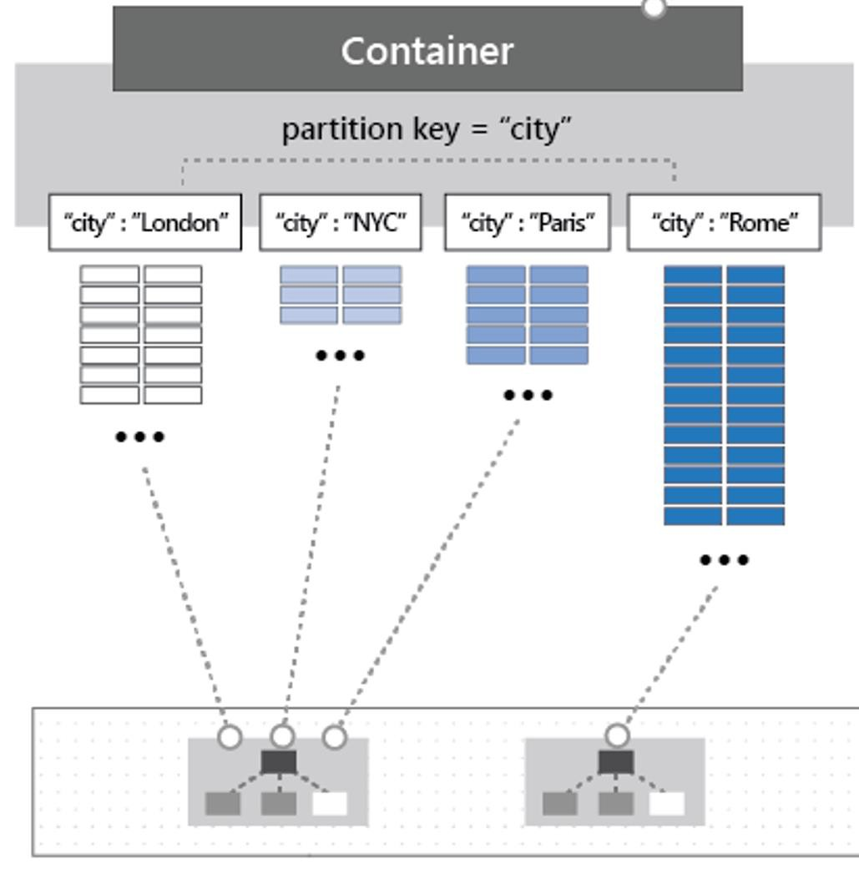
Partitioning
Partitioning: the items in a container are divided into distinct subsets called logical partitions.
Partition key is the value by which Azure organizes your data into logical divisions.
Logical partitions are formed based on the value of a partition key that is associated with each item in a container.
Physical partitions: Internally, one or more logical partitions are mapped to a single physical partition.

Slide 33
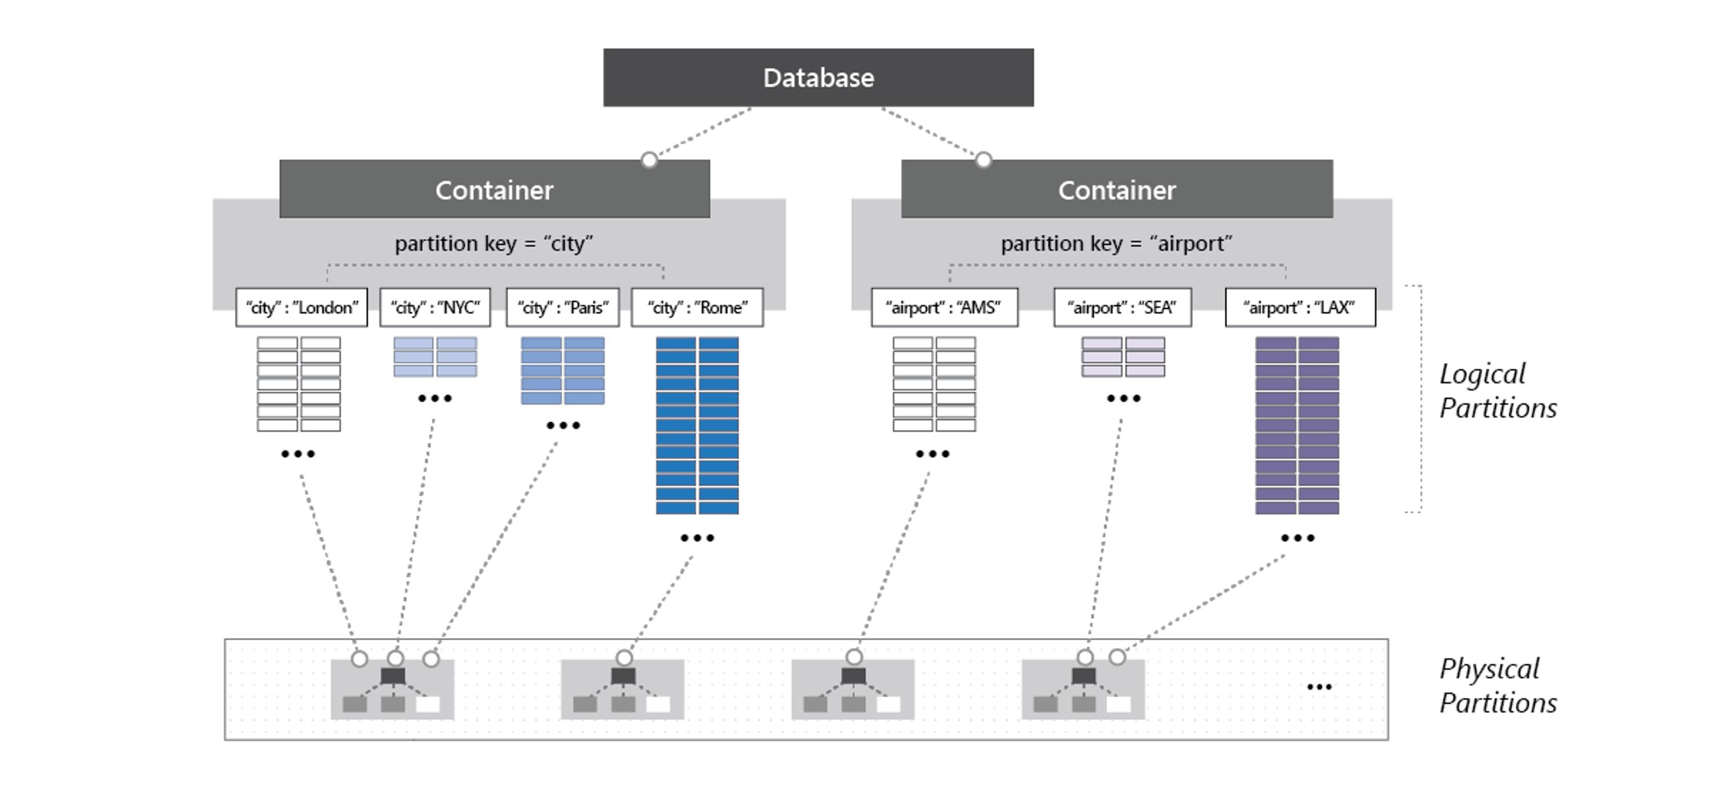
Partitioning

Slide 34
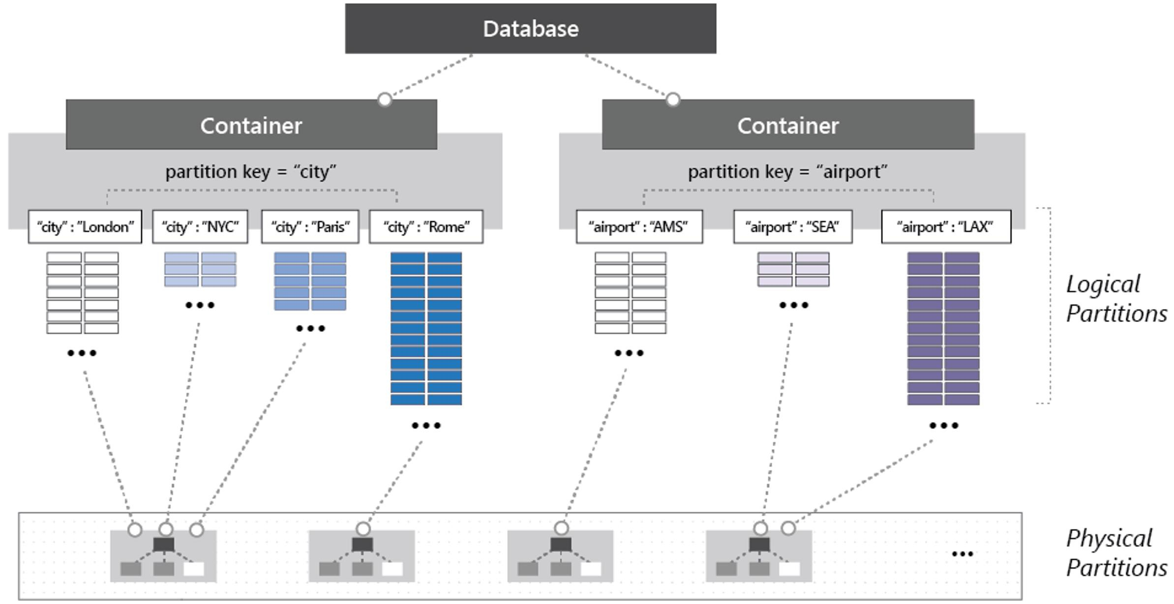
Dedicated vs Shared throughput

Slide 35





Dedicated vs Shared throughput
Database
Container 1
Container 2
Container 3

Slide 36
Dedicated vs Shared throughput
You can set throughput at:
Database level – Shared throughput
Container level – Dedicated throughput
It is recommend to set throughput at container level.
Rate-Limited
Choose at the time of creation

Slide 37
Avoiding hot partition

Slide 38

Avoiding hot partition
Logical Partition 1
Logical Partition 2
Logical Partition 3
Logical Partition 4
(2500 RUs)
(2500 RUs)
(2500 RUs)
(2500 RUs)
Container (10,000 RUs)

Slide 39



Avoiding hot partition
Container

Slide 40
Avoiding hot partition at store
Container

Slide 41

Avoid Hot partitions on throughput
Container
Partition key Bad choice: Current time
Partition key Good choices: User ID, Product ID

Slide 42





Single partition Query
John
Brian
Tom
Mark
Container
SELECT * FROM c WHERE c.username = ‘Brian’

Slide 43

Cross partition Queries (fan out queries)
Amit
Brian
Tom
Mark
Container
SELECT * FROM c WHERE c.favoritecolor= ‘Blue’

Slide 44

Composite Key
Amit
Brian
Tom
Mark
Container
Composite Key: CustomerName-mmddyyyy

Slide 45
Choosing a Partition key
Evenly distribute storage
Make sure you pick your partition key that doesn't result in hot spots within your applications
Have a high cardinality
Don’t be afraid of choosing a partition key that has a large number of values
Example User Id & Product Id
Evenly distribute requests.
RUs evenly distribute across all partitions.
Review where clause of top queries
Consider document and partition limit while designing partition key.
Max document size – 2 MB
Max logical partition size – 20 GB

Slide 46
Choosing a Partition key
Question: Your organization is planning to use Azure Cosmos DB to store vehicle telemetry data generated from millions of vehicles every second. Which of the following options for your Partition Key will optimize storage distribution?
Answer choices:
Vehicle model
Vehicle Identification Number (VIN) which looks like WDDEJ9EB6DA032037

Slide 47


Choosing a Partition key
Question: Your organization is planning to use Azure Cosmos DB to store vehicle telemetry data generated from millions of vehicles every second. Which of the following options for your Partition Key will optimize storage distribution?
Answer choices:
Vehicle model
Most auto manufactures only have a couple dozen models. This option is potentially the least granular, will create a fixed number of logical partitions, and may not distribute data evenly across all physical partitions.
Vehicle Identification Number (VIN) which looks like WDDEJ9EB6DA032037
Auto manufacturers have transactions occurring throughout the year. This option will create a more balanced distribution of storage across partition key values.

Slide 48


Automatic Indexing
Index all data without requiring Index management
Every property of every record automatically index
Index update synchronously as you create, update or delete items
Not specific for SQL, but available for all APIs

Slide 49

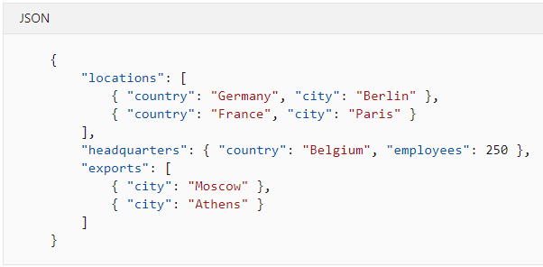



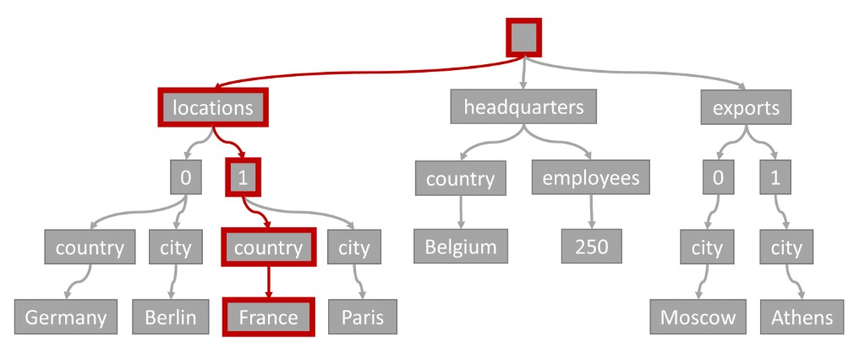

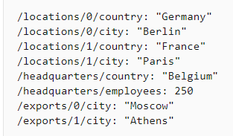
Automatic Indexing
SELECT location
FROM location IN company.locations WHERE location.country = 'France'

Slide 50

Time to Live (TTL)
You can set the expiry time for Cosmos DB data
items
Time to live value is configured in seconds.
The system will automatically delete the expired items based on the TTL value
Consume only leftover Request units
Data deletion delay if not enough Request units
Though the data deletion is delayed, data is not returned by any queries (by any API) after the TTL has expired.
Time-to-Live

Slide 51
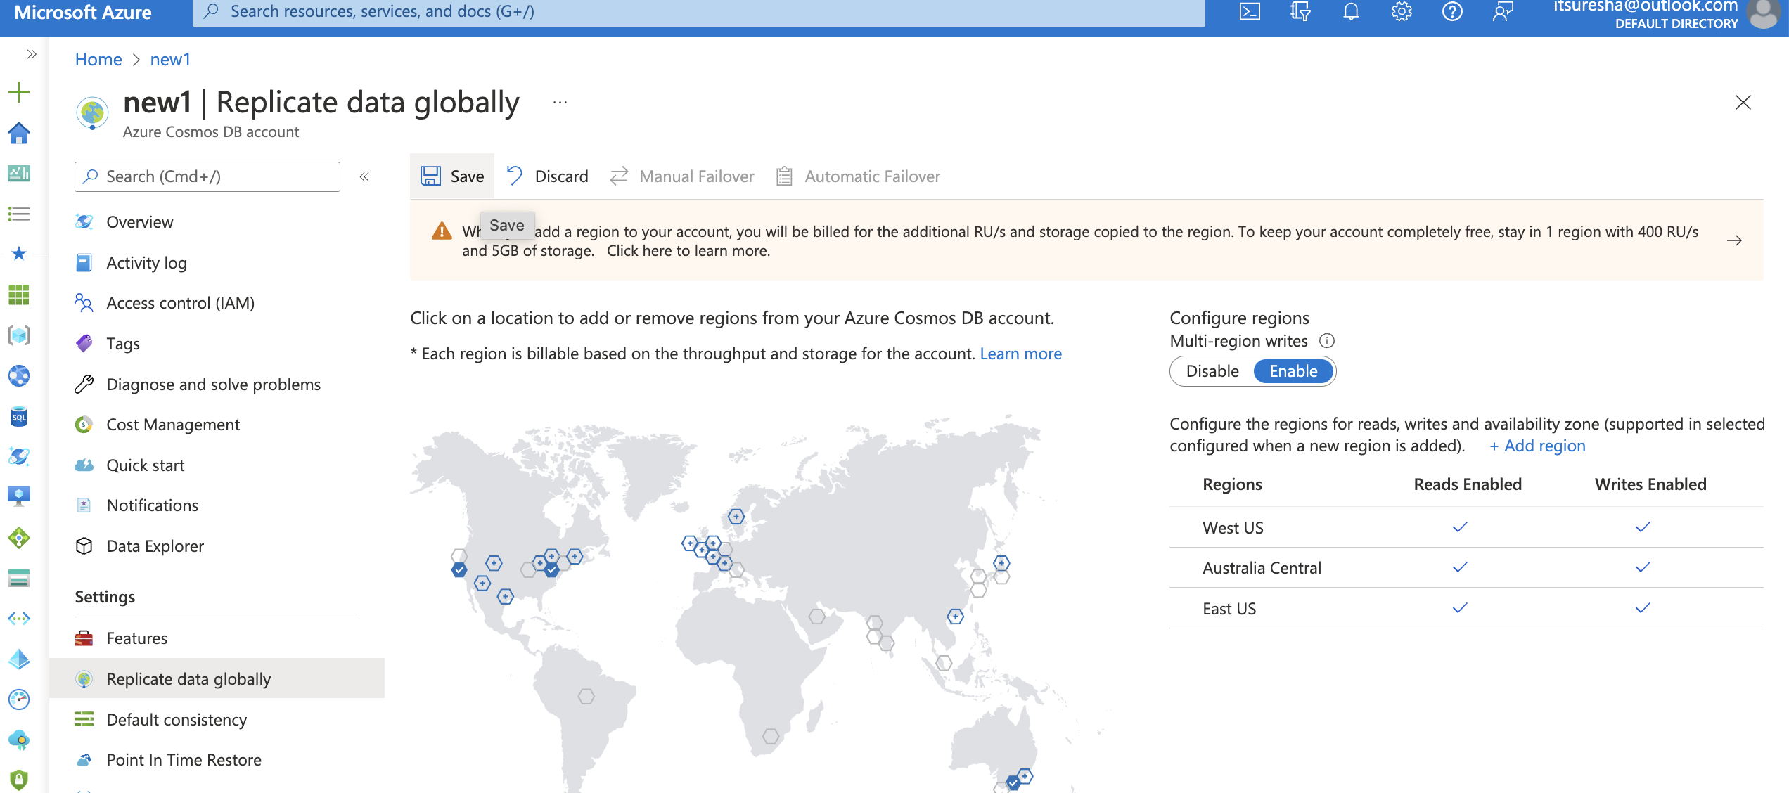

Slide 52
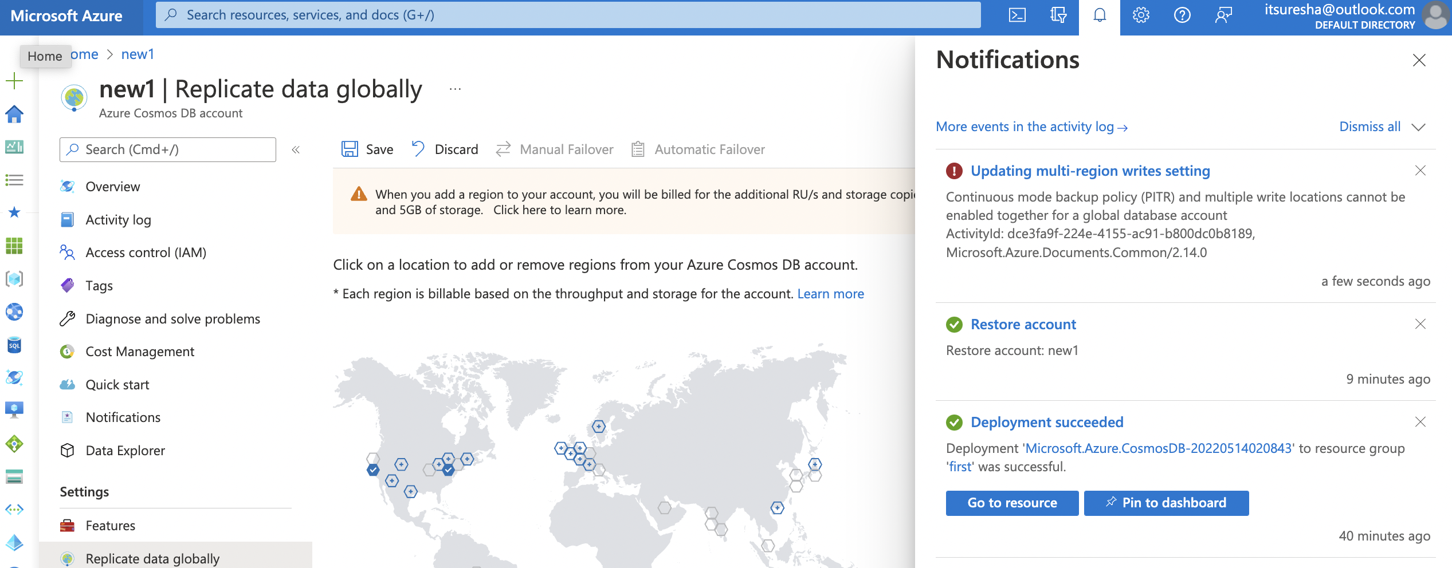

Slide 53
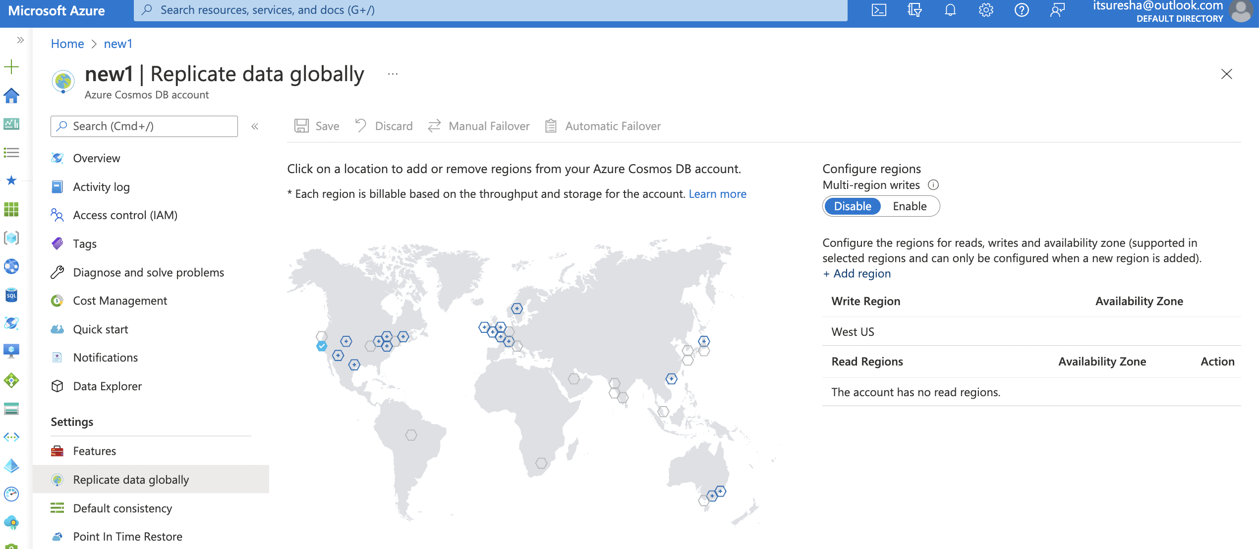

Slide 54
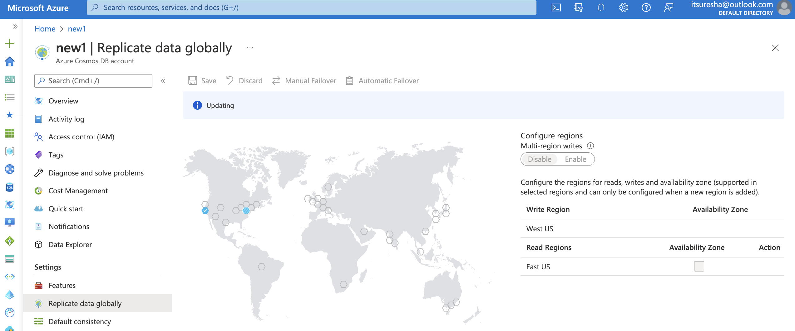

Slide 55
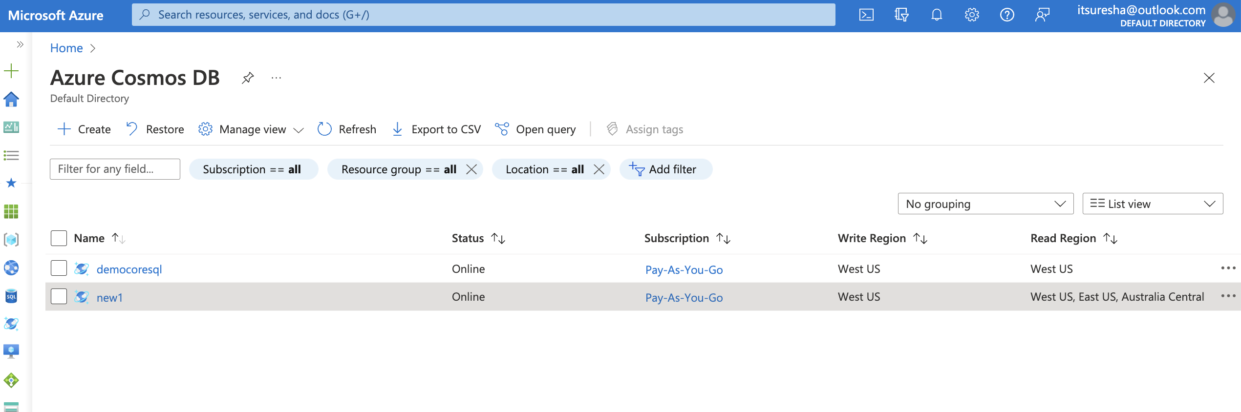

Slide 56
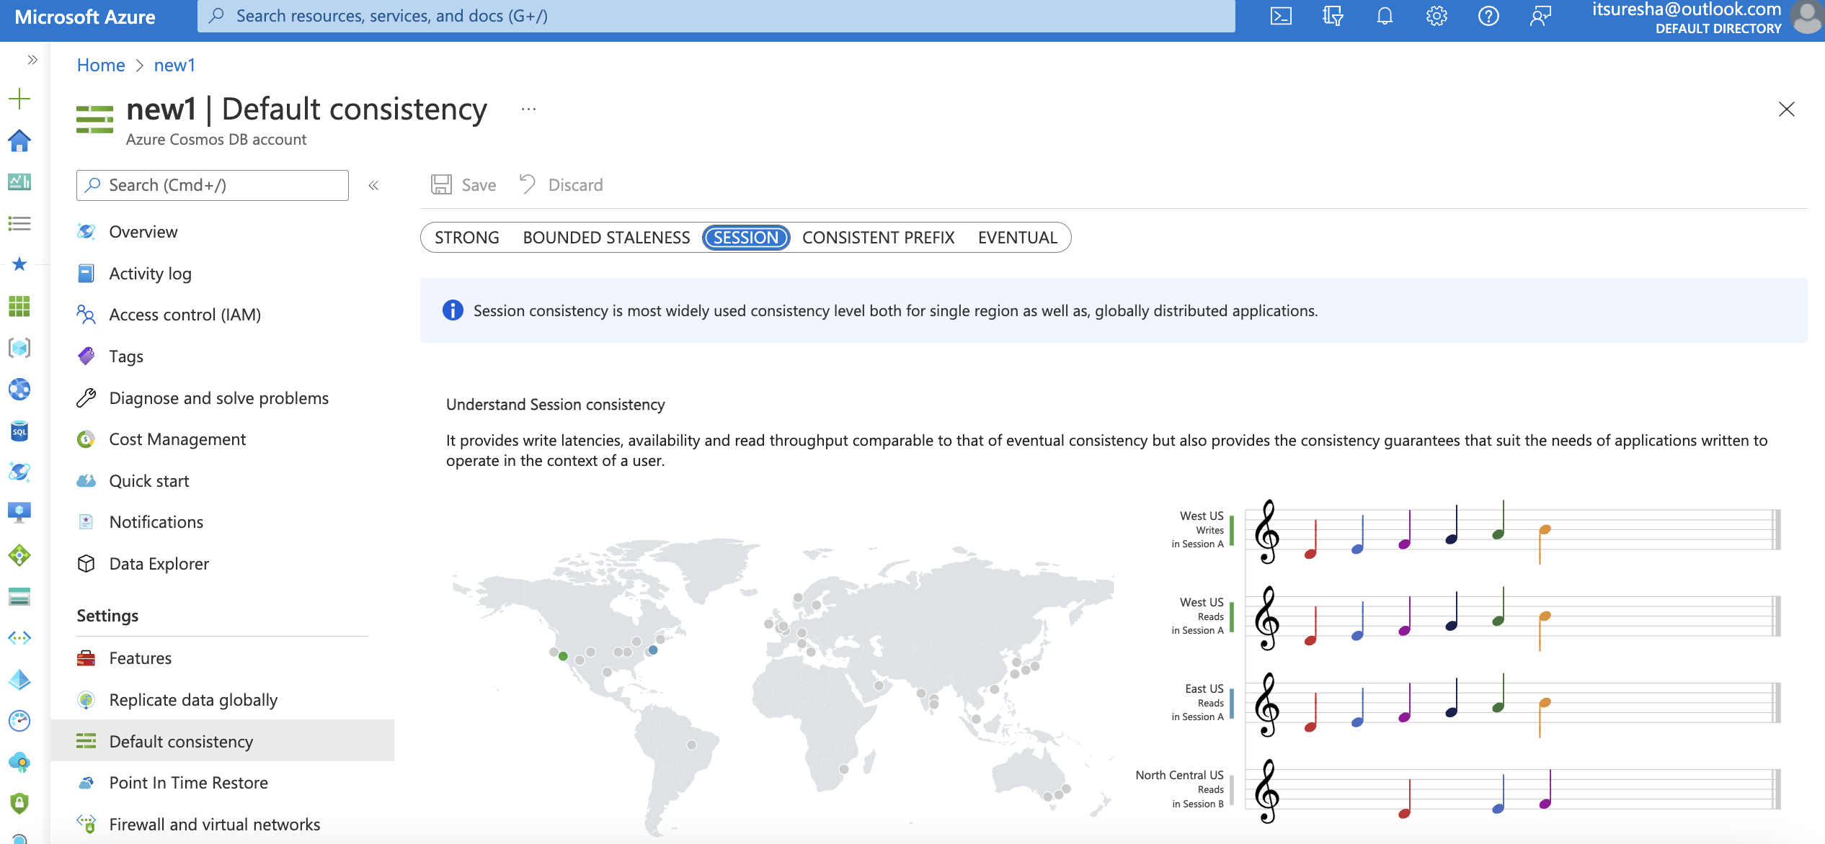

Slide 57
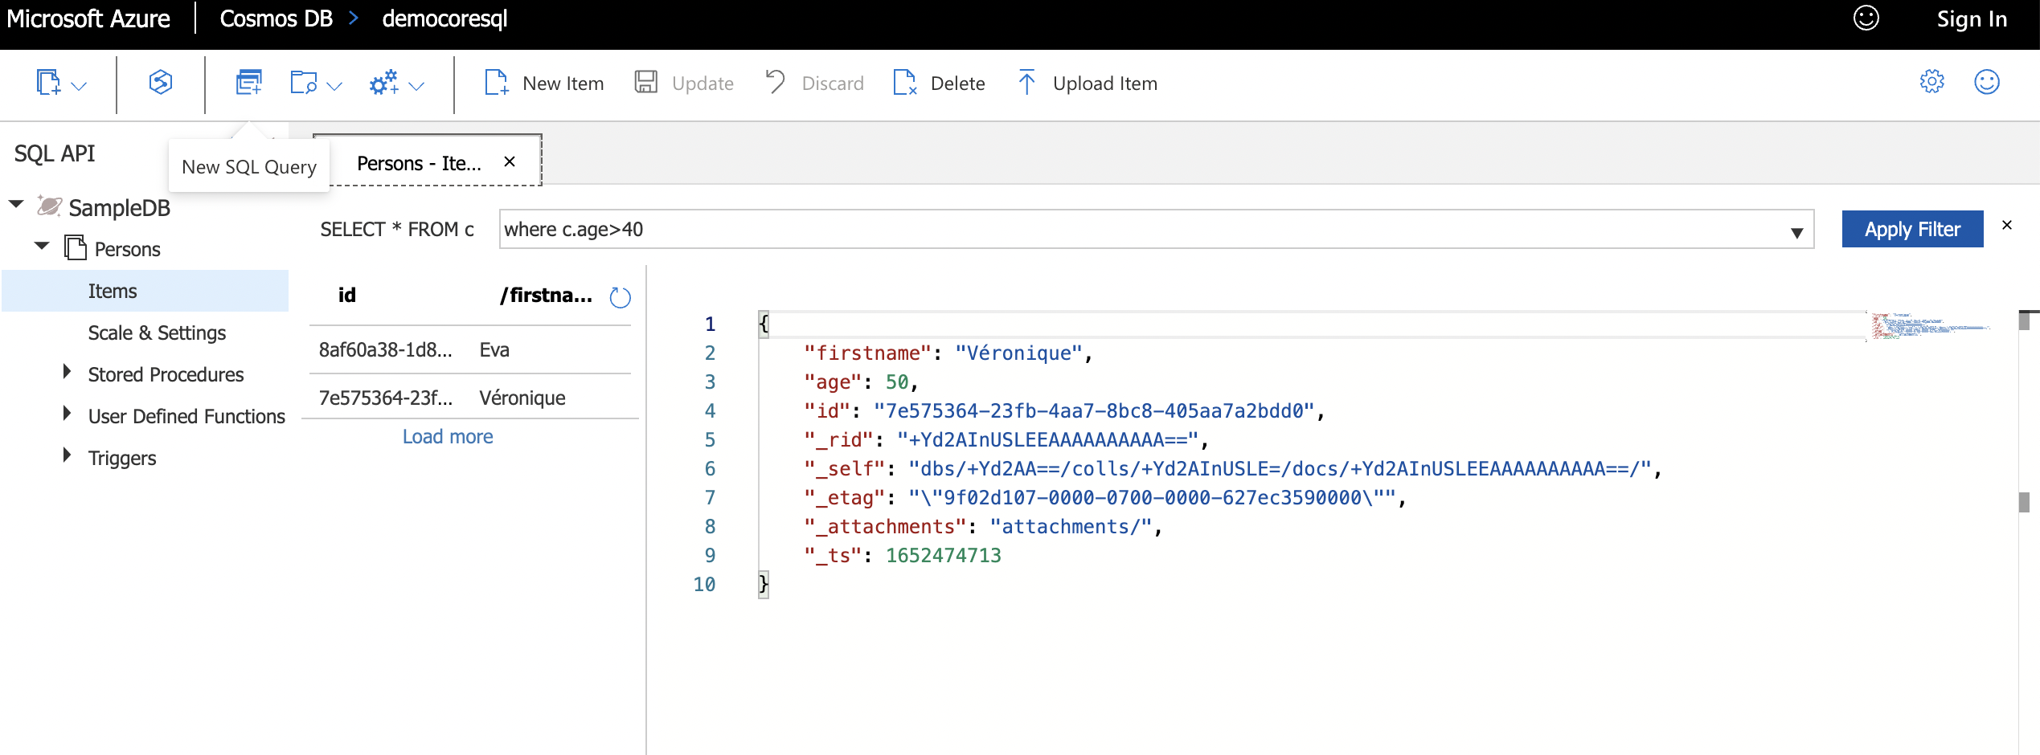

Slide 58
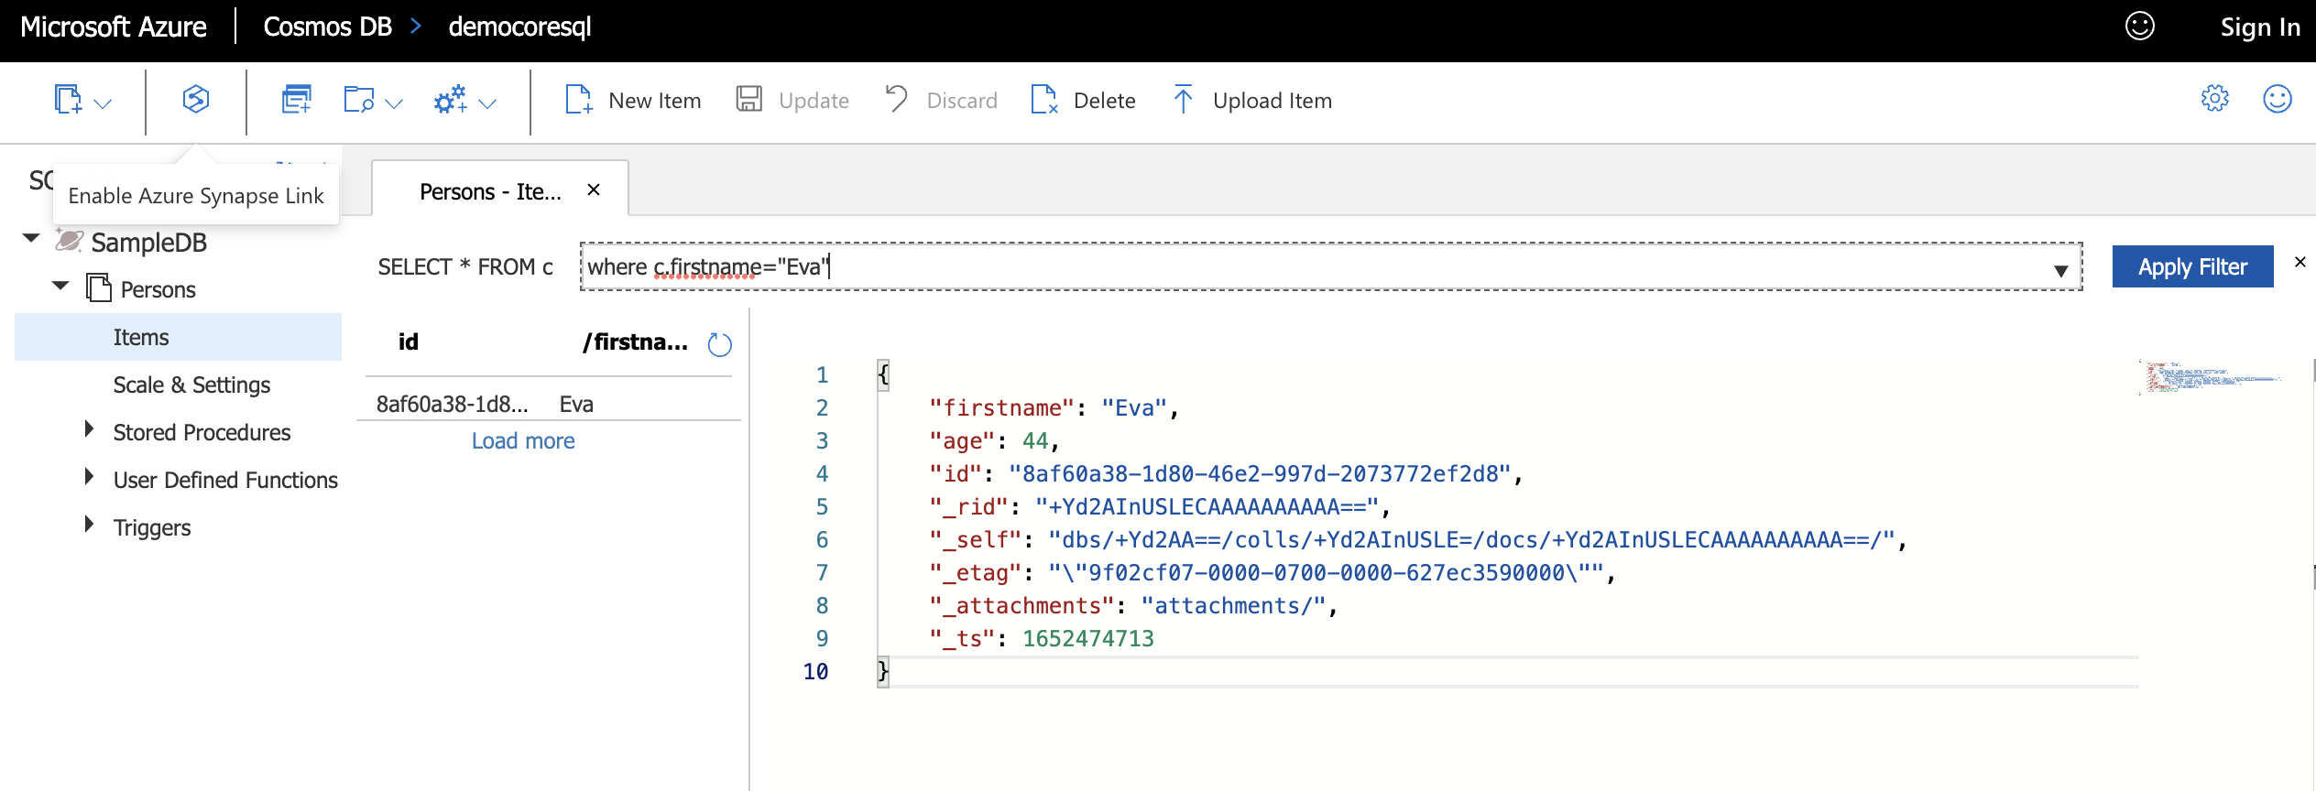

Slide 59
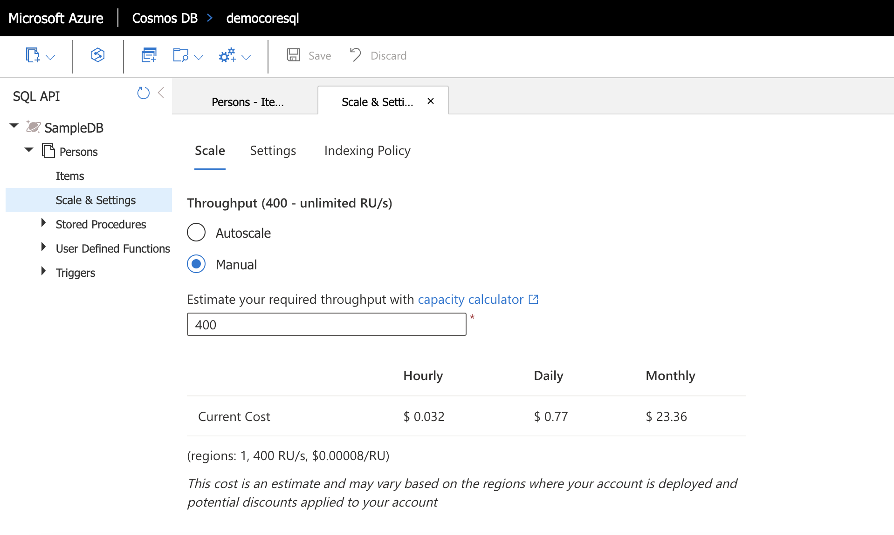

Slide 60
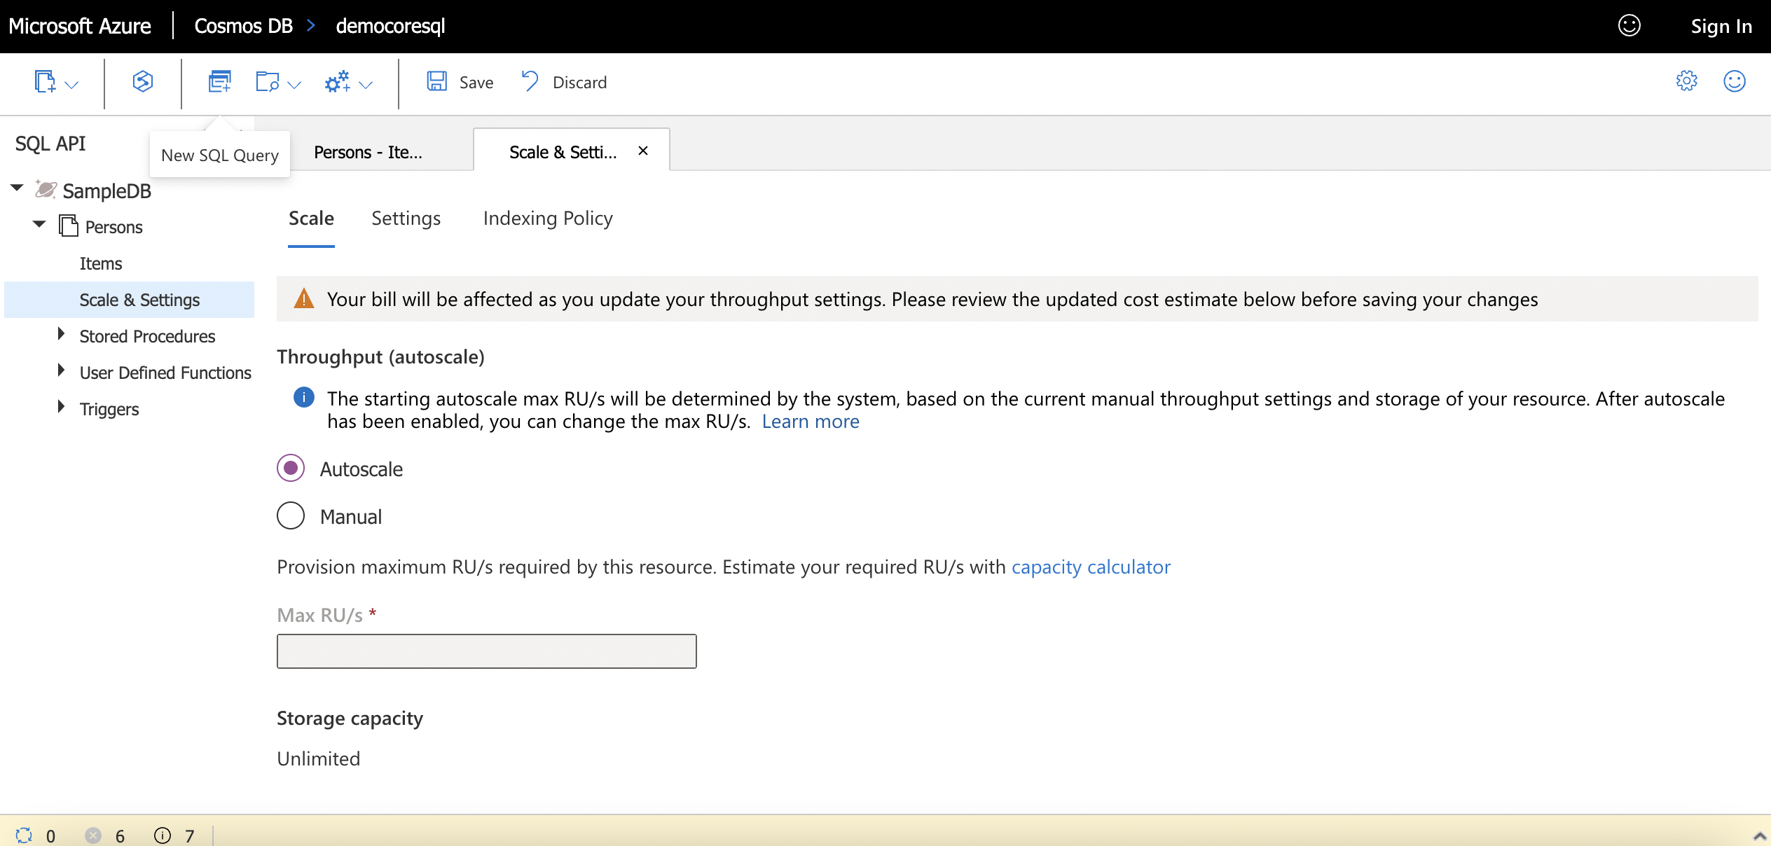

Slide 61
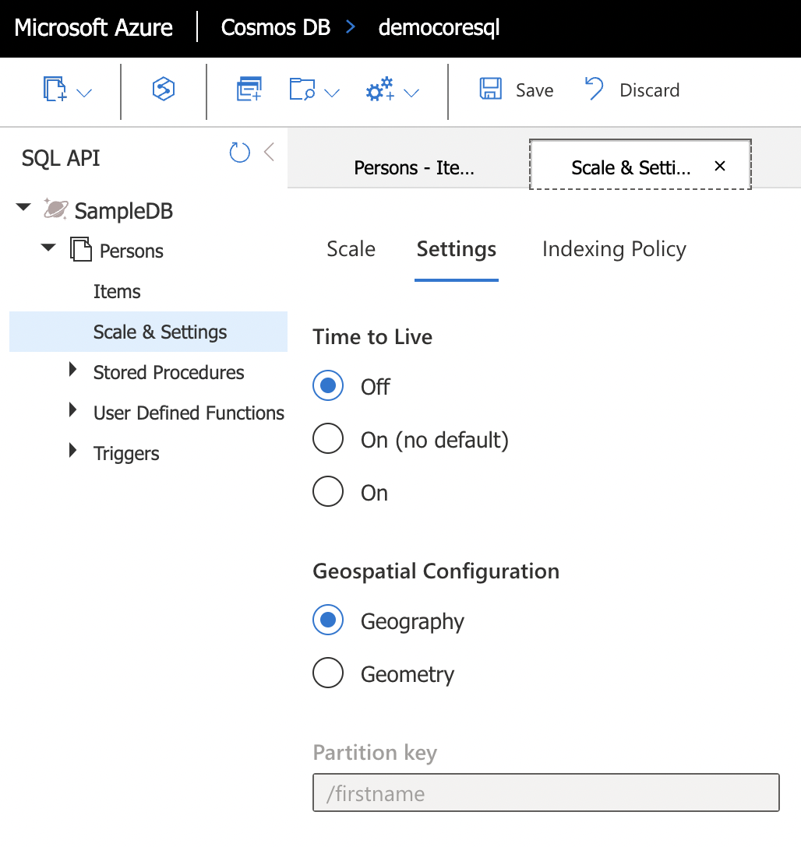
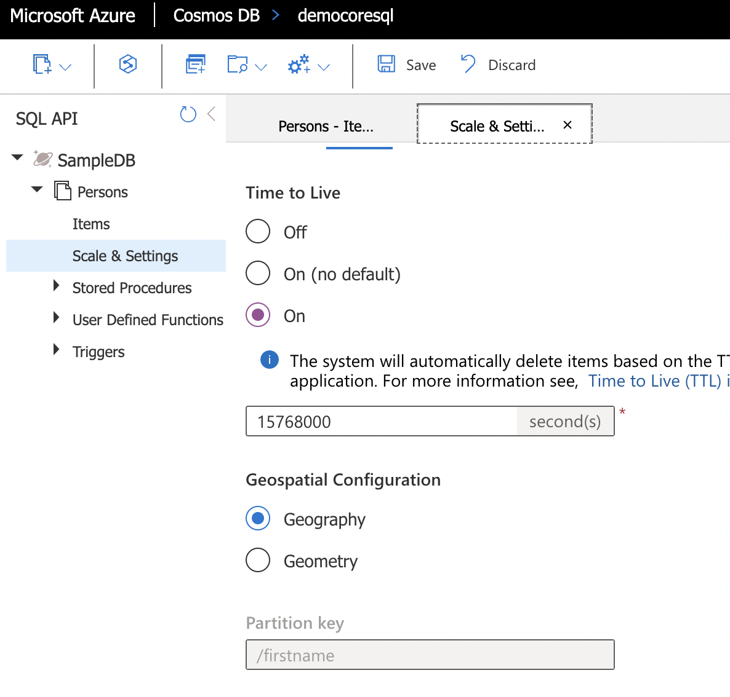

Slide 62


Slide 63


Slide 64

Data consistency
Replication
5 seconds
West US
East US
At 10.00 AM
Update CreditScore = 750
At 10:00:02 AM
Read CreditScore

Slide 65


CAP Theorem
There is a risk of some data becomes unavailable
Client may read inconsistent data
Data may not be
immediately available

Slide 66
CAP Theorem
It is impossible for a distributed computer system to simultaneously provide all three of the following guarantees:
Consistency: all nodes see the same data at the same time
Availability: a guarantee that every request receives a response on whether it was successful or failed
Partition tolerance: the system continues to operate despite arbitrary message loss or failure of part of the system
According to the theorem, a distributed system can satisfy any two of these guarantees at the same time, but not all three.

Slide 67





Five consistency Levels
Bounded Staleness
Consistent Prefix
Strong
Session
Eventual
Strong Consistency
Weaker Consistency
Higher latency
Lower availability
Lower latency Higher availability
Strong: No dirty reads, high latency, cost highest, closest to RDBMS
Bounded staleness: Dirty reads possible, bounded by time and updates
Session: No dirty reads for writers (within same session), dirty read possible for other users
Consistency prefix: Dirty reads possible but sequence maintain, reads never see out-of-order writes
Eventual: No guaranteed order, but eventually everything gets in order

Slide 68







Setting the consistency level
Set default for entire
account
Can be changed any time
Override at request level
Any request can weaken the default consistency level
Bounded Staleness
Consistent Prefix
Strong
Session
Eventual
Strong Consistency
Weaker Consistency
Higher latency Lower availability
Lower latency
Higher availability

Slide 69


Q&A ?

